Slide 1
stretching

Slide 2
Recognize the 5 leading back injury risk factors
  Poor posture
  Poor physical condition
  Improper body mechanics
  Incorrect lifting
  Extra abdominal weight

Slide 3
Lift properly
Lock your spine in an upright position.
Use the strongest muscles in your body – legs.
Keep the load close to your body.
Get help if needed.
Don’t be a hero.
Plan your route.
Don’t use your back as a crane!

Slide 4
Stretching exercises at work
  Stretching and exercise can:
    Relax tight muscles.
    Improve circulation.
    Improve flexibility.
    Increase strength and stamina.
    Increase energy levels.
    Increase resistance to illness.
    Decrease the time to recover from illness.

Slide 5
While performing stretches and exercise at work
Remember to breathe.
Stretch gently.
Go easy at first.
Develop a routine.
Stop if pain occurs.

Slide 6
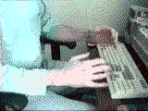
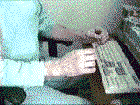
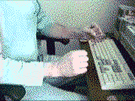
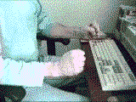
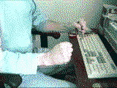
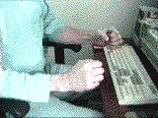
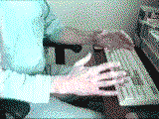
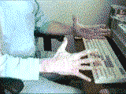
Hand and finger stretch
Hold a fist for 2 to 3 seconds, then hold fingers stretched for 2 to 3 seconds:
1
2
3
4
5
6
7
8

Slide 7
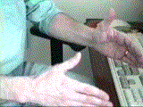
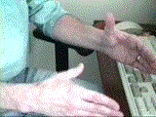
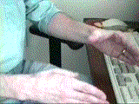
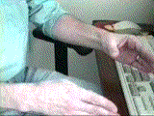
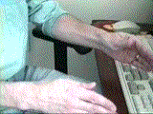
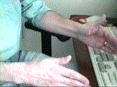
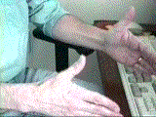
Thumb rotation stretch
Rotate the thumbs both Clockwise and Counter-clockwise:
1
2
3
4
5
6
7

Slide 8
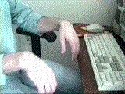
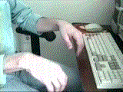
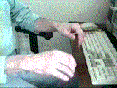
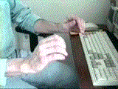
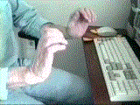
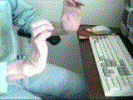
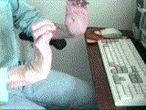
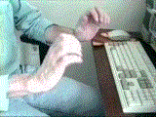
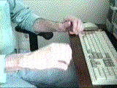
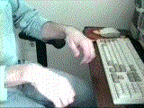
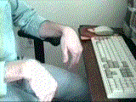
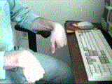
Wrist stretch
Hold for 2 to 3 seconds at the end of each movement (upper and lower):
1
2
3
4
5
6
7
8
9
10
11
12

Slide 9

The following stretching exercises work to stretch the joints and muscles that are shortened and tight when you sit or work in forward posture.
  Neck Stretch:
  Tilt ear toward shoulder.
  Reach up and touch top of head with palm to hold in tilted position.
  Hold 10 seconds. Repeat 2-3 times (come out of stretch very slowly.) Reverse side.

Slide 10
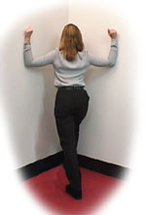
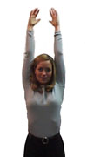
Pec Corner Stretch:
Stand in a corner about a foot away from the wall with forearms on opposite sides of the corner. One foot should be forward.
Elbows should be slightly below shoulder height.
Keep abdominals tight to avoid arching back.
Lean gently in towards corner by bending the front knee until a stretch is felt in front of the chest.
Hold 15 seconds - Repeat 2-3 times.
Overhead Reach:
  Take a deep breath and reach up over head with both arms.
  Hold a couple seconds.
  Exhale and lower slowly.
  Repeat 5 times.

Slide 11
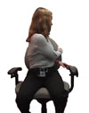

Shoulder Pinch:
Place arms behind head being careful not to press hand into head.
Relax shoulders, and squeeze shoulder blades together while keeping shoulders back and down.
Hold 5 seconds - Repeat 5 times.
Chair Rotation Stretch:
Sit in chair, and if you can, wrap feet around chair legs.
Reach across body and grab back of chair.
Pull gently to increase stretch in mid back.
Hold 5 seconds - Repeat 5 times.

Slide 12
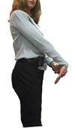
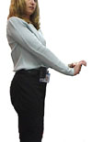
Forearm Stretches:
Wrist flexed/ fingers straight
Hold arm straight at waist height.
With fingers of other hand, gently press down above the knuckles-bending wrist down. **(Do not hold at the fingers to push down.)** Hold for 5-10 seconds.
Keep shoulder relaxed when stretching.
Repeat 2-3 times.
B. Wrist extended/ fingers point up
Hold arm straight at waist height with palm facing away from you and fingers pointing up.
Hold onto palm of hand and stretch wrist back. ** (Do not pull on fingers.)
Make sure the fingers and thumb (on the hand that is pushing the other hand back) are kept together.
Hold 5-10 seconds. Repeat 2-3 times.

Slide 13


Thoracic Spine Extension Stretch:
Lie on your back with a pillow under your knees. Place a firmly rolled towel under your shoulder blades across your upper back.
Raise arms up as you inhale.
Lower arms as you exhale, and hold a couple of seconds.
Do this 5 times.
Prop Ups or Press Ups:
Lie on stomach and either prop up on forearms, or if wrists are not compromised, press up through hands.
Let stomach sag, and allow back to arch without using back muscles.
If propped on elbows, hold 5-10 seconds. Repeat 5 times.
If on hands, press up and down slowly 10 times.

Slide 14
Best stretch for low back
Lay on back
Pull one or both knees towards chest
Go as far as your resistance will allow
Hold for 10-15 seconds
Slowly release
Repeat 5 or more times

