Slide 1
Fatal incident review

Slide 2
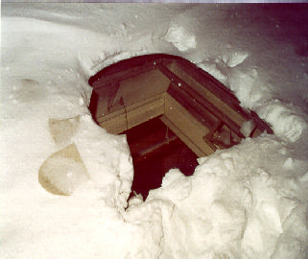
Fall through snow covered skylight

Slide 3
The Incident
A 43-year-old laborer at a manufacturing company died after falling through a skylight and landing on a concrete floor 14 feet below. The victim and a co-worker had volunteered to clear snow from the roof of the company building after their regular work day was finished.

Slide 4
Recommendations
To prevent future fatalities of this type, Roofers and employers should:
Install barrier guards around skylight openings.
Lock all doors that provide access to unguarded rooftops.
Provide training in the recognition and avoidance of unsafe conditions to workers who are assigned tasks outside their normal duties.
MARK ALL ROOF PENETRATIONS!

Slide 5
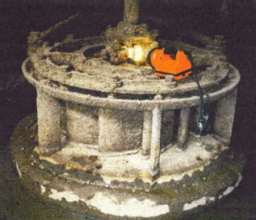
Safety rope caught in roating shaft

Slide 6
The incident
The victim apparently slipped while he was walking past turbine and fell toward the spinning shaft. His safety rope got caught on a shaft coupling, and his harness was pulled tight to the shaft. His body stopped the rotation of the turbine shaft.

Slide 7
Recommendations
To prevent similar occurrences, employers should:
Install a locking brake to stop the rotation when maintenance and repair is necessary.
Develop and implement an energy control (lockout/tagout) program for all activities.
Train workers in the recognition and avoidance of unsafe conditions before they.

Slide 8
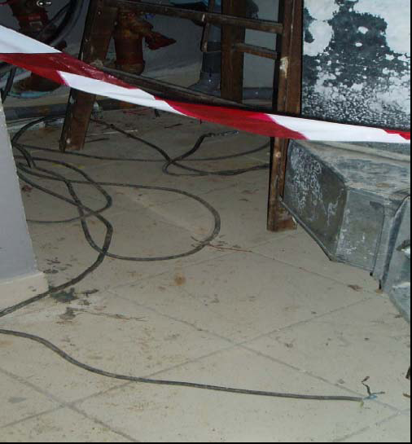
Electrocution
Ladder came in contact with bare wire.

Slide 9
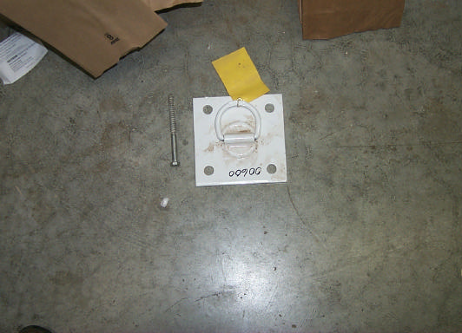
Improper anchorage

Slide 10
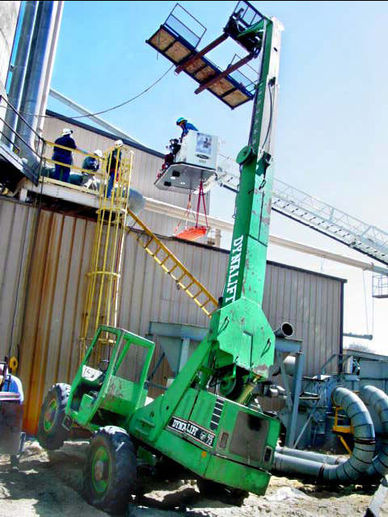
Uneven ground

Slide 11
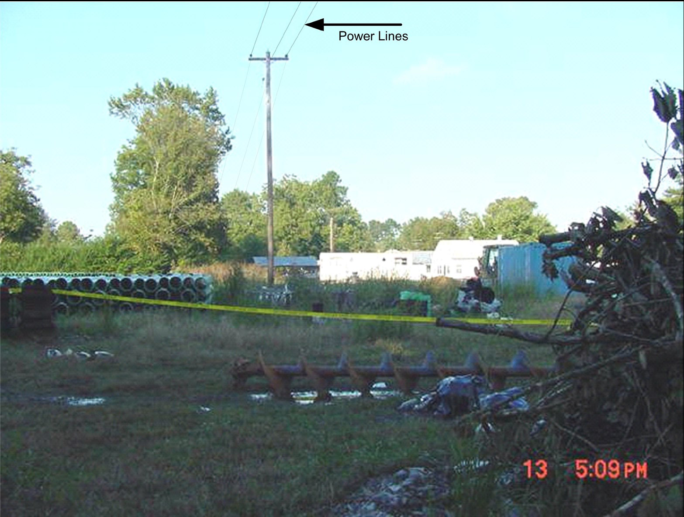
Crane contact with power

Slide 12
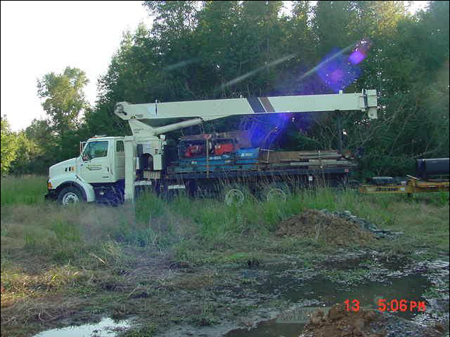
Crane Contact with Power

Slide 13
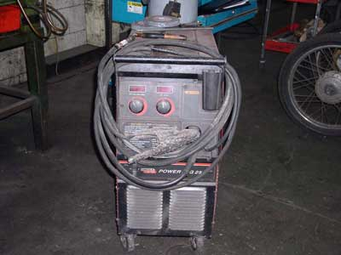
Welding diesel fuel tank

Slide 14
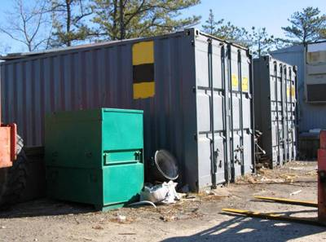
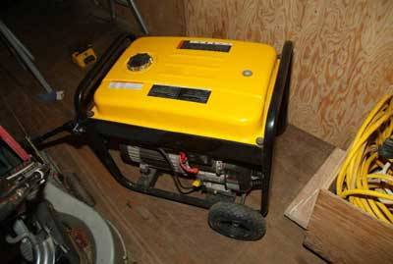
Generator in confined space

Slide 15
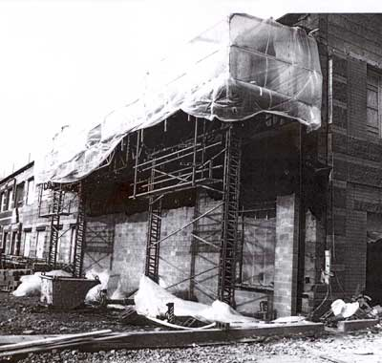
56 Year old climbing scaffold - fall

Slide 16
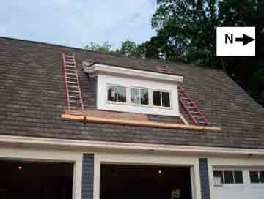
Fatal Fall

Slide 17
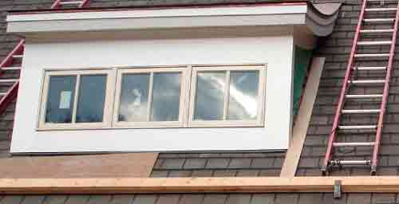
63 year old male

Slide 18
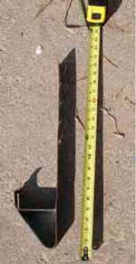
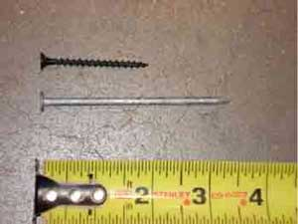
Small slide guard Drywall screws instead of 16d nails

Slide 19
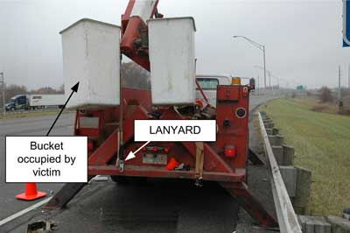
Boom Chain failure

Slide 20
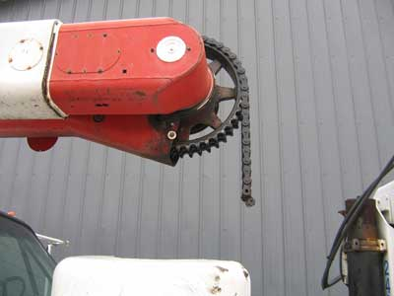
Boom Chain failure

Slide 21
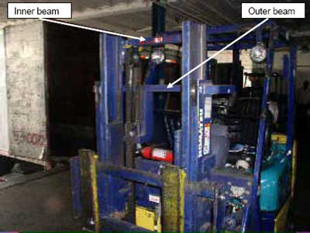
Forklift

Slide 22
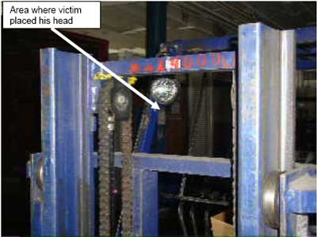
Forklift

Slide 23
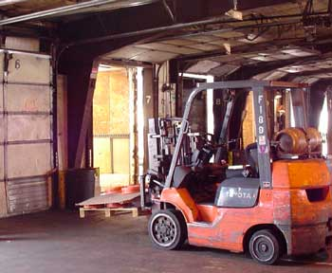
18 year old Forklift Operator

Slide 24
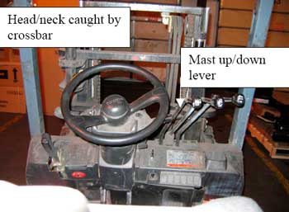
Forklift

Slide 25
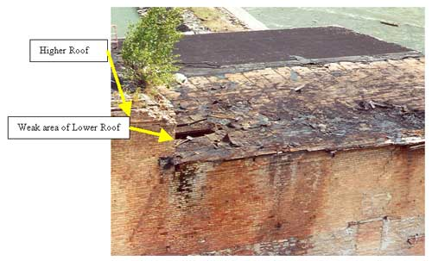
Fall through Roof Deck

Slide 26
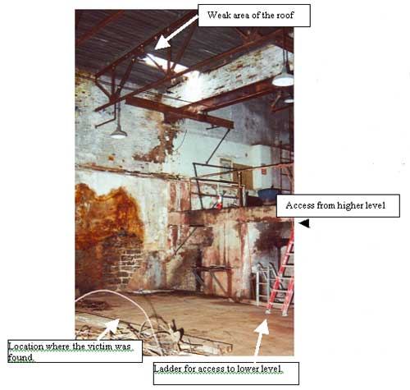
Fall through Roof Deck

