Slide 1
Fall protection systems

Slide 2
Why do we need fall protection?

Slide 3
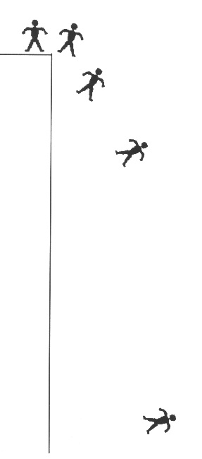
Anatomy of a Fall
.33sec./2 feet
.67 sec./7 feet
It takes most people about 1/3 of a second to become aware.
It takes another 1/3 of a second for the body to react.
A body can fall up to 7 feet in 2/3 of a second.
1 sec./16 feet
2 sec./64 feet

Slide 4
Statistics
How Can the Numbers Focus Our Efforts?

Slide 5
Falls
Falls are one of the leading cause of fatalities.
In 2005 there where approximately 469 fatal falls, with the trend on the increase.
The cost of care for injuries related to falls is a financial burden for all industry.

Slide 6
What Is Fall Protection?
A series of reasonable steps taken to eliminate or control the injury effects of an unintentional fall while working at a height.

Slide 7
Philosophies of Fall Protection
Stop/Prevent The Fall
Catch The Fall
Restraint/Positioning
Fall Arrest
Guardrails
Safety Nets
Warning Lines
Catch Platforms
Controlled Access Zones
Controlled Decking Zones
Safety Monitors
Notes:
Do these stop/prevent the fall?
CAZ – No, it merely attempts to limit employee access. Human error, misjudgment, and inattentiveness can be a problem
CDZ – Similar to CAZ, a CDZ is an area defined in Subpart R where positive fall protection is not required, and a “plan” can be used to protect employees. Human error, misjudgment, and inattentiveness can be a problem
Safety Monitors – Do not necessarily prevent falls, their function is to warn employees of potential hazards as they occur. Human error, misjudgment, and inattentiveness can be a problem

Slide 8
Planning for Fall Protection
Best practice dictates that fall protection becomes an integral part of the project planning process, from constructability, to systems installation, to use and maintenance.
A project cannot be truly safe unless fall protection is incorporated into every aspect of the workplace.
Planning will keep workers safe and minimize liability for all parties involved.
Notes:
While a plan is not required for all projects, and is not required to be written in any case, having a written, jobsite and hazard-specific plan is recommend. Remember that training (employee orientation to the specifics) is a critical component of a good plan

Slide 9
Controlling Fall Exposures
Select fall protection systems appropriate for given situations.
Use proper construction and installation of safety systems.
Supervise employees properly.
Use safe work procedures.
Train workers in the proper selection, use, and maintenance of fall protection systems.
Evaluate the effectiveness of all steps.
Notes:
OSHA recognizes that accidents involving falls are generally complex events frequently involving a variety of factors. Only a systematic approach to fall exposures will help to minimize the potential for these accidents

Slide 10
Fall Protection Systems and Components

Slide 11
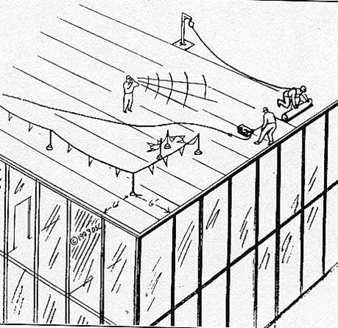
Methods of Roof Fall Protection
Fall Arrest
Safety Monitors
Guardrails and warning lines
Notes:
When performing roofing activities, not necessarily working on roofs…
Roof means the exterior surface on the top of a building. This does not include floors or formwork which, because a building has not been completed, temporarily become the top surface of a building.
Roofing work means the hoisting, storage, application, and removal of roofing materials and equipment, including related insulation, sheet metal, and vapor barrier work, but not including the construction of the roof deck.

Slide 12
Flat/Low Slope
4:12 Slope or Less
Beyond the Use of Guardrails, OSHA Allows the Use of:
Warning Lines
Safety Monitors
Recommended:
Guardrails or PFAS where feasible.
Limited use of lines and monitors on flat roofs only.
Notes:
When performing roofing activities, not necessarily working on roofs
Low-slope roof means a roof having a slope less than or equal to 4 in 12 (vertical to horizontal).

Slide 13
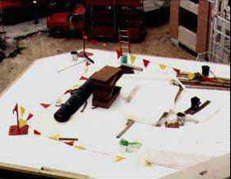
Roof Warning Lines
Must be 6 feet back from edges.
Warning lines must be maintained at 34 - 39” above the working surface.

Slide 14
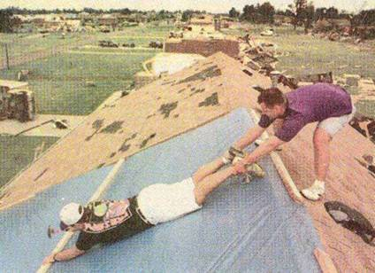
Safety Monitor
Oversees work outside the warning lines.
Establishes the procedure to protect.
Workers must receive special training.
Use should be extremely limited

Slide 15
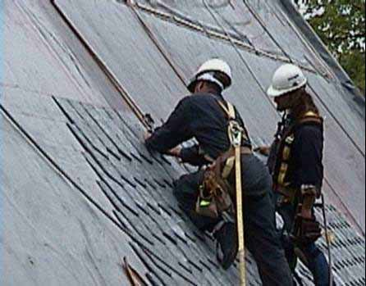
High Slope
Over 4:12 Slope
OSHA Mandates:
Guardrails
Catch Platforms
Nets
Restraint Devices
Personal Fall Arrest Systems (PFAS)
Notes:
See interpretations for guidance
Steep roof means a roof having a slope greater than 4 in 12 (vertical to horizontal).

Slide 16
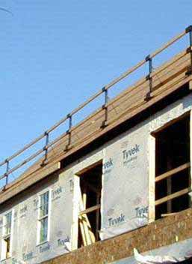
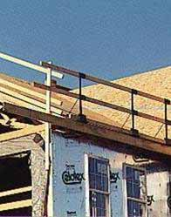
Roof Guardrails
Guardrails are a positive option on high slope roofs
Notes:
Ensure that employees cannot slide through guardrail
See STD 03-00-001 - STD 3-0.1A - Plain Language Revision of OSHA Instruction STD 3.1, Interim Fall Protection Compliance Guidelines for Residential Construction for complete details

Slide 17
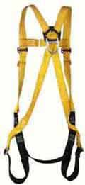




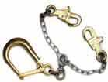
Personal Fall Arrest Systems
Harnesses
Caribiners
Rope Grabs
Anchorage
Body Harness
Connector
Beam Wraps
Positioning
Lanyards

Slide 18
Anchorages
Must support 5000 lbs. per employee attached:
Or as part of a complete personal fall arrest system which maintains a safety factor of at least two.
Or 3000 lbs. when using fall restraint or a Self-Retracting Lifeline (SRL, Retractable, or “yo-yo”) which limits free fall distance to 2 feet.
Should always be at or above D-ring height.
Notes:
NOTE---HORIZONTAL LIFELINES---ONLY OPTION IS TWICE MAXIMUM ARRESTING FORCE – which will require some calculation, unless using a manufactured system in accordance with the manufacturers’ requirements

Slide 19


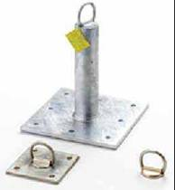
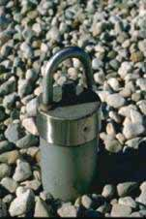
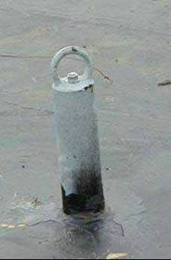
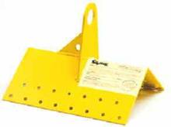
Roof & Deck Anchors
Wood Roof
Anchor
Permanent
Anchors
Metal Roof
Anchor

Slide 20
Use of Eye Bolts
Rated for loading parallel to the bolt axis.
If wall mounted, the rating perpendicular to the axis must be good for 5,000 lbs. per employee.
Rated
Needed

Slide 21

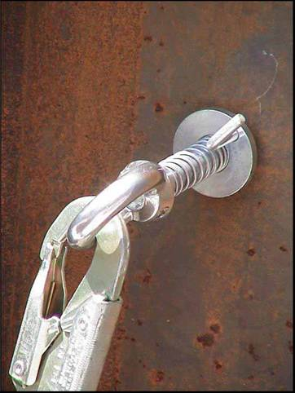
Girder Grip Anchorage Rings
These attachments can be mounted through bolt holes on steel members.
They are rated at 5,000 lbs. in all directions.
Notes:
Another possible anchorage connector that can be inserted in bolt holes.

Slide 22
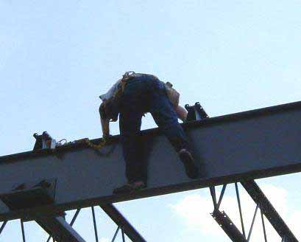
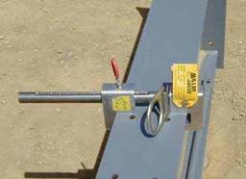
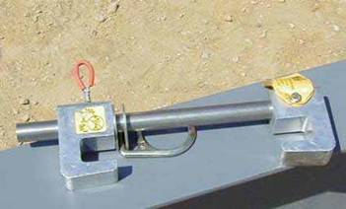
Bean clamps
Beam clamps can make an effective anchorage when used properly, and with the correct lanyard.
TIGHT
BEAM CLAMP
PIN SET
Be sure pin is inserted full length and clamp is tight.
Notes:
What happens when the employee reaches the next joist? He/she needs a second beamer to make the traverse over the joist end, otherwise will not be tied off 100% of the time. Also, some prefabricated building rafters/joists may not be suitable for the application of a beamer, as the flange is too thin to support the potential impact.

Slide 23
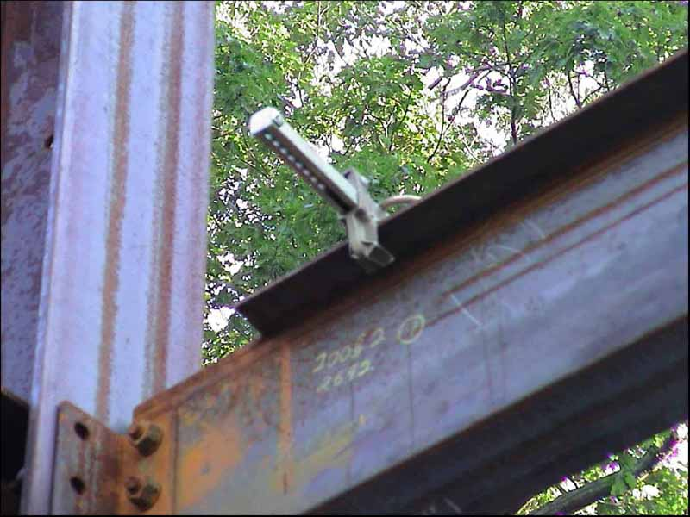
Beware of potential for pulling off of coped ends on filler beams!
Notes:
Many beams are coped back (top flange removed) to a point where the beamer is narrow enough to slip off of the end. This has happened, and employees below have been hit by the falling beamer! (Not to mention the fact that the employee above may lose his/her balance)

Slide 24
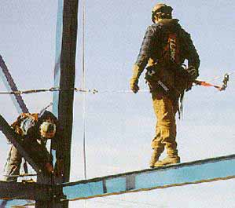

Horizontal Life Lines
Provide maneuverability.
Must be designed, installed and used under the guidance of a qualified person.
Notes:
Shall be designed, installed, and used, under the supervision of a qualified person, as part of a complete personal fall arrest system, which maintains a safety factor of at least two.

Slide 25
Line Stanchions
The connection of the line stanchion to the flange must support the bending moment applied to the base.
Notes:
This shows the potential moment force on the connection of a 3 foot high stanchion.

Slide 26
Body (Harnesses)
Need to be inspected frequently (daily before use by the worker, at least monthly by a Competent Person).
Should never be modified.
Should be taken out of service immediately if defective or exposed to an impact.
Notes:
Note: Body belts are excluded as of 1/1/98
Note: If the personal fall arrest system meets the criteria and protocols contained in Appendix C to subpart M, and if the system is being used by an employee having a combined person and tool weight of less than 310 pounds (140 kg), the system will be considered to be in compliance with the provisions of paragraph (d)(16) of this section. If the system is used by an employee having a combined tool and body weight of 310 pounds (140 kg) or more, then the employer must appropriately modify the criteria and protocols of the Appendix to provide proper protection for such heavier weights, or the system will not be deemed to be in compliance with the requirements of paragraph (d)(16) of this section.
1926.502(d)(17)
The attachment point of the body belt shall be located in the center of the wearer's back. The attachment point of the body harness shall be located in the center of the wearer's back near shoulder level, or above the wearer's head.
1926.502(d)(18)
Body belts, harnesses, and components shall be used only for employee protection (as part of a personal fall arrest system or positioning device system) and not to hoist materials.
1926.502(d)(19)
Personal fall arrest systems and components subjected to impact loading shall be immediately removed from service and shall not be used again for employee protection until inspected and determined by a competent person to be undamaged and suitable for reuse.
1926.502(d)(20)
The employer shall provide for prompt rescue of employees in the event of a fall or shall assure that employees are able to rescue themselves.
..1926.502(d)(21)
1926.502(d)(21)
Personal fall arrest systems shall be inspected prior to each use for wear, damage and other deterioration, and defective components shall be removed from service.

Slide 27
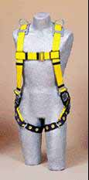
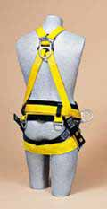
Harness Fitting
Harness must be sized for the worker
Chest strap tightened at mid chest.
“D” ring between shoulder blades.
Proper snugness shoulder to hips.
Leg straps snug but not binding.
Butt strap supports the load.

Slide 28
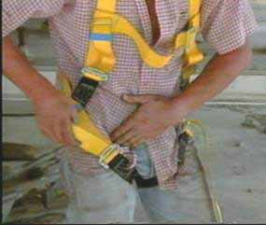
Proper Adjustment Is Key
“Rules of Thumb”
Be able to reach your D-ring with your thumb.
Maximum Four (flat) Fingers of Slack at the legs, straps as high as comfortably possible.
Ensure chest strap is across the chest/breastbone.
Have a buddy double check for twists, etc.

Slide 29
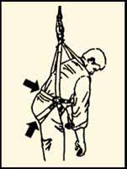
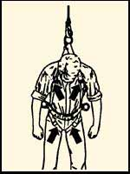
Harness Pressure Points
Spread load across butt strap and belt strap if on the harness
Excess pressure here can cut blood flow to the legs
Some studies have indicated permanent damage to the lower extremities when the worker hangs for more than twenty (20) minutes

Slide 30
Connectors (Lanyards)
Should be inspected before each use.
Should not be tied back to themselves (unless specifically designed for such use).
Should be worn with the impact absorber/shock pack at the d-ring.
Should have the appropriate clip for the intended anchorage points.
Do not use large climbing/rebar/ladder hooks with “beamers”.

Slide 31
Free Fall Distance
How far a worker falls before shock absorbing or deceleration equipment begins to take effect.
Affects both impact forces and total fall distance.
Anchorage point location in relation to D-ring height.
Below the D-ring allows excessive falls.
Above the D-ring minimizes free fall to less than 6’.
Notes:
See interpretations for additional guidance.

Slide 32
Impacting Structures Below (Total Fall Distance)
Consider:
Anchorage point location in relation to D-ring height
Lanyard length
Harness elongation
Shock absorber opening length
Body below D-ring
Body viscosity (soft tissue injuries!)
Notes:
See interpretations for additional guidance.

Slide 33
Impacting Structures Below (Total Fall Distance)
6’ Lanyard Length
3.5’ Deceleration Device
5’ From D-Ring to Worker’s Feet
Total 18.5’ below anchorage point
3’ Safety Factor (stretch, bounce, etc.)
All distances are approximate, and shown for illustration only. This is why it is critical to maintain the safety factor distance!
Notes:
See interpretations for additional guidance.

Slide 34
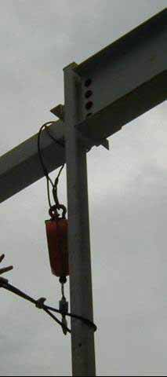
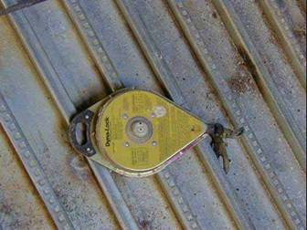
Retractable Lifelines
Very effective for vertical applications.
Will normally lock up in 1 –2 feet, minimizing total fall distance and impact forces on the worker’s body.

Slide 35
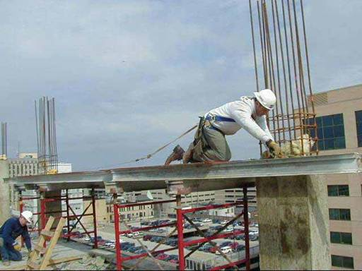
Do Not Hook Lanyards To a Retractable!
This worker is hooked to a retractable lifeline with his lanyard.
This can cause hook failures and affect the locking capability of the retractable.
The retractable should be attached directly to the “D” ring.

Slide 36
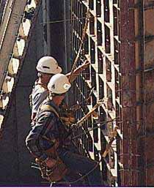
Positioning Systems
Positioning Devices Provide Hands-free Work.
Additional Fall Protection (tie-off) may be required to move or access.
Notes:
For use on vertical surfaces only

Slide 37
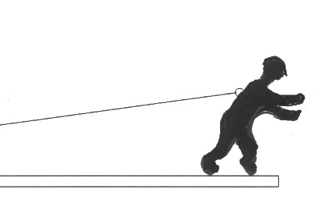
Fall Restraint
Fall restraint assumes the employee cannot reach the edge.
He is basically on a short leash.
If the employee could reach to the edge and fall over the edge, he must be in fall arrest.
Restraint Line
Edge

Slide 38
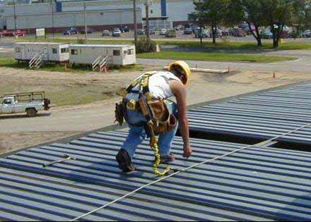
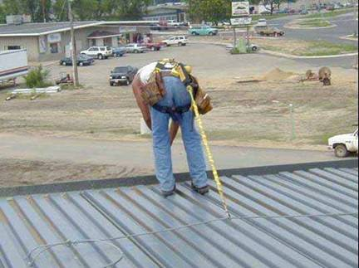
Use of restraint cables
Example of restraint cables used during deck anchoring.
RESTRAINT CABLE

Slide 39
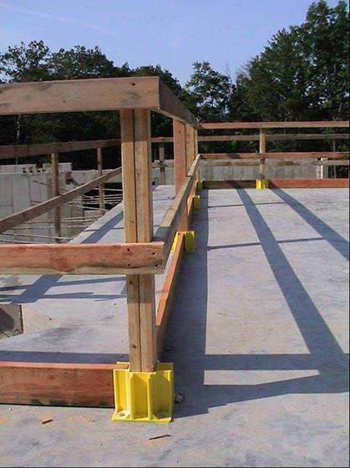
Wood Guardrail Construction
Proper Height
Midrails
Toeboards
Adequate Strength
Notes:
42” plus or minus 3”, must support 200# in an outward or downward direction. Must be surfaced to prevent injury. All posts cut flush.

Slide 40
Use of Braces for Guardrails
Brace can be used as a Top Rail.
Notes:
Although allowed (and in some instances required by site conditions, such as to prevent a fall to the inside of a scaffold from an outrigger), the use of cross bracing as either guardrail is not a recommended practice.

Slide 41
Use of Braces for Guardrails
Brace can be used as a Mid Rail
Install Top Rail
< 48"
20 - 30"
Platform
Notes:
Although allowed (and in some instances required by site conditions, such as to prevent a fall to the inside of a scaffold from an outrigger), the use of cross bracing as either guardrail is not a recommended practice.

Slide 42
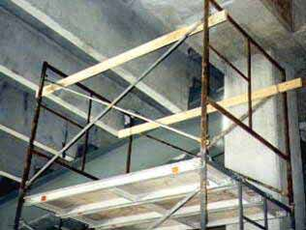
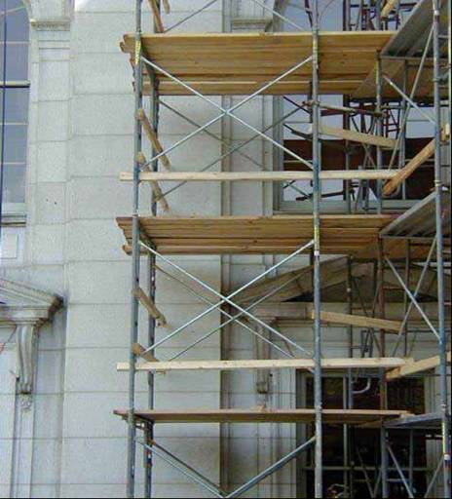
Braces as Guardrails
The guardrails are in compliance using a 2x4 as one rail and the brace as the other rail.
May not be the safest way.
Notes:
Although allowed (and in some instances required by site conditions, such as to prevent a fall to the inside of a scaffold from an outrigger), the use of cross bracing as either guardrail is not a recommended practice.

Slide 43
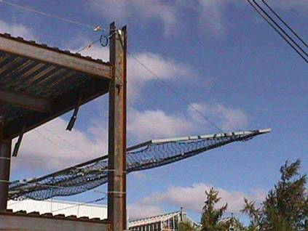
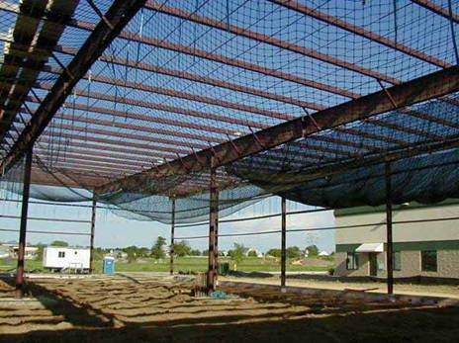
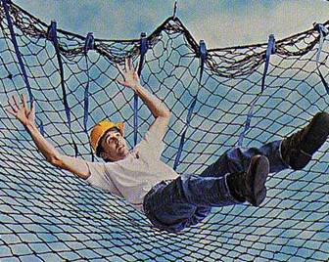
Use of Safety Nets
Assumes the fall will occur.
Assumes adequacy of the system (or requires testing).
Notes:
Test after installation, or certification by competent person – do you want to become liable for that system by signing off on it?
Ensure that employees cannot contact lower levels or net support structure
Even if employees do not hit deck or steel, a thirty foot (allowable) fall into a net can still cause injuries
Inspect for debris
Ensure that employees cannot contact lower levels or net support structure

Slide 44
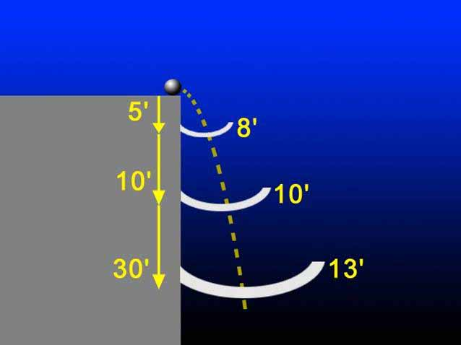
Nets

Slide 45
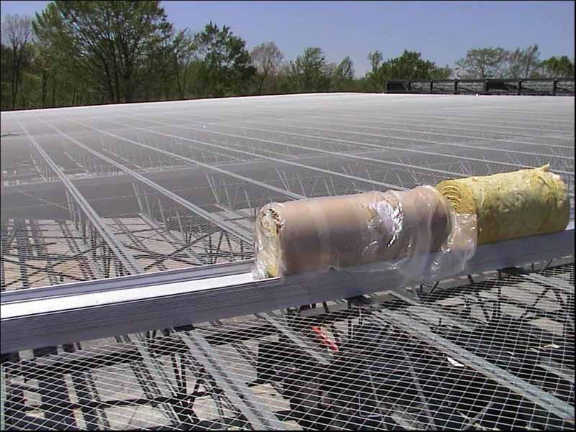
Sky web

Slide 46
Planning For Rescue
Worst-case Scenario?
Notes:
911 is not necessarily an adequate response

Slide 47
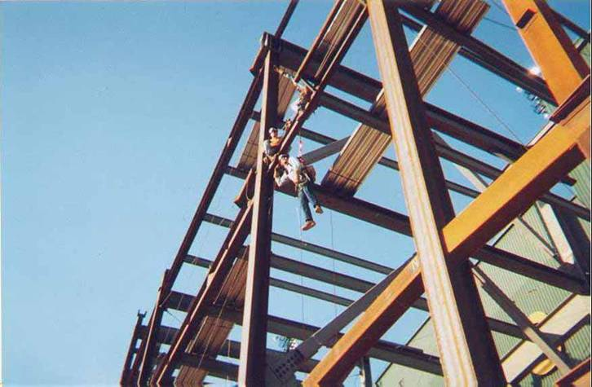
When All Works!

Slide 48
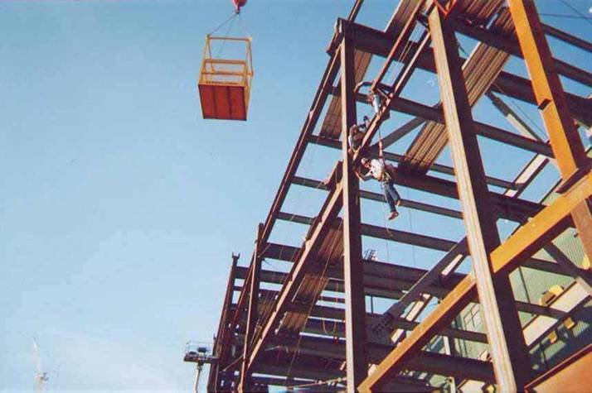
Rescue Plan Put Into Motion
Notes:
Follow requirements in 1926.550(g) for the use of personnel platforms

Slide 49
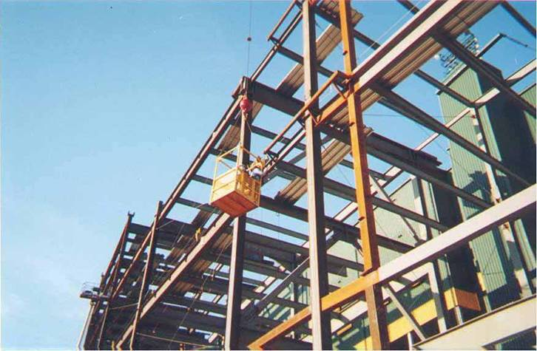
Safe

Slide 50
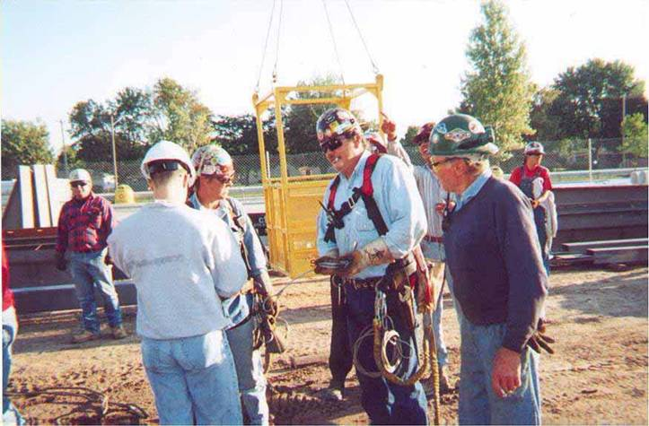
On The Ground And Still Alive!

