Slide 1
Fires & extinguishers

Slide 2
What you will learn
Types of Fires
Fire Triangle
Types of Extinguishers
How to Use an Extinguisher
Rules for Fires

Slide 3
Types of Fires
Fires Are Classified by the type FUEL they burn.
The 4 Types are:
A: Wood, Paper, Plastic, Rags
B: Gasoline, Oil, Grease, Paint
C: Office Equipment, Motors, Switchgear, Heaters
D: Potassium, Sodium, Aluminum, Magnesium

Slide 4
Fire Triangle
Fires Require:
Air (oxygen): Is required as a catalyst.
Oxygen from the air or from the fuel itself.
Fuel: For a fire to start there must be something to burn.
Heat: For a fire to start there must be a hear or ignition source.

Slide 5
Types of Extinguishers
Type of fire extinguishers are classified by the type fires on which they may be used.

Slide 6
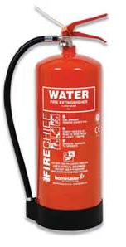
Class A
Used on Wood, Paper, Plastic

Slide 7
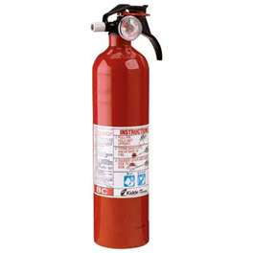
Class B
Used on Flammable Liquid Fires

Slide 8
Class C
Used on Electrical Fires

Slide 9
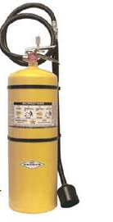
Class D
Used on Metal Fires

Slide 10
Using A Fire Extinguisher
Use the PASS System:
Pull …
The pin, this will allow you to discharge the extinguisher.
Aim…
At the base of the fire.
If you aim at the flames, the extinguishing agent will fly right through and do no good. You want to hit the fuel.
Squeeze…
The top handle or lever, this depresses a button that releases the pressurized extinguishing agent in the extinguisher.
Sweep…
From side to side until the fire is out

Slide 11
Rules for Fires
Fires are very dangerous.
Be certain that you will not endanger yourself or others when attempting to put out a fire.
Pull the fire alarm.
Call 911
Assist anyone danger.
Never fight a fire if you don't know what is burning.
If you don't know what is burning, you don't know what type of extinguisher to use.

Slide 12
Rules for fires (continued)
Even if you have an ABC extinguisher, there may be something in the fire which is going to explode or produce highly toxic smoke.
Never fight a fire if the fire is spreading rapidly beyond the spot where it started.
The time to use an extinguisher is in the incipient, or beginning, stages of a fire.
If the fire is already spreading quickly, it is best to simply evacuate the building, closing doors and windows behind you as you leave.

Slide 13
Rules for fires (continued)
Never Fight a fire if you don't have adequate or appropriate equipment.
If you don't have the correct type or large enough extinguisher, it is best not to try to fight the fire.
Never fight a fire if you might inhale toxic smoke.
If the fire is producing large amounts of smoke that you would have to breathe in order to fight it, it is best not to try.
Gases from man made materials can be fatal in very small amounts.

Slide 14
Rules for fires (continued)
Never fight a fire if your instincts tell you not to.
If you are uncomfortable with the situation for any reason, just let the fire department do their job.
The final rule is to always position yourself with an exit or means of escape at your back before you attempt to use an extinguisher to put out a fire.
In case the extinguisher malfunctions, or something unexpected happens, you need to be able to get out quickly, and you don't want to become trapped. Just remember, always keep an exit at your back.

