Slide 1
Hazard identification

Slide 2
Safety has an impact on every thing we do

Slide 3
By Complying with the standards, we keep OSHA happy
Inspect your workplace…and correct!
Train your workers…and document!
Discipline the bad actors…and document!
Provide safe equipment.
Insist on a clean shop.
Get rid of the junk!

Slide 4
Common OSHA violations
Lack of MSDS sheets and Hazard Communication program.
Lack of a PPE program, respiratory.
Lock out tag out, jack stands and key control.
Electrical- bad cords cause death.
Forklift – certify your operators, seatbelts.
Fall protection over 4 feet.
Tools, eyewash, first aid kits, chemical labeling.
Emergency plan.

Slide 5
learn to identify hazardous situations
And you will…
Prevent Incidents.
Cut insurance costs.
Cut indirect costs.
Provide a safe place for our employees.
Interest future clients through reputation.

Slide 6
Chemical Storage, Pringles can?, labeling

Slide 7
Chocking of wheels

Slide 9
Electrical

Slide 10
Housekeeping, blocked electrical

Slide 11
Housekeeping

Slide 12
Extinguishers, blocked by cord

Slide 13
Extension cords, household cord?

Slide 14
Powered Industrial Trucks various hazards

Slide 15
Egress

Slide 16
Electrical

Slide 17
Egress

Slide 18
Electrical

Slide 19
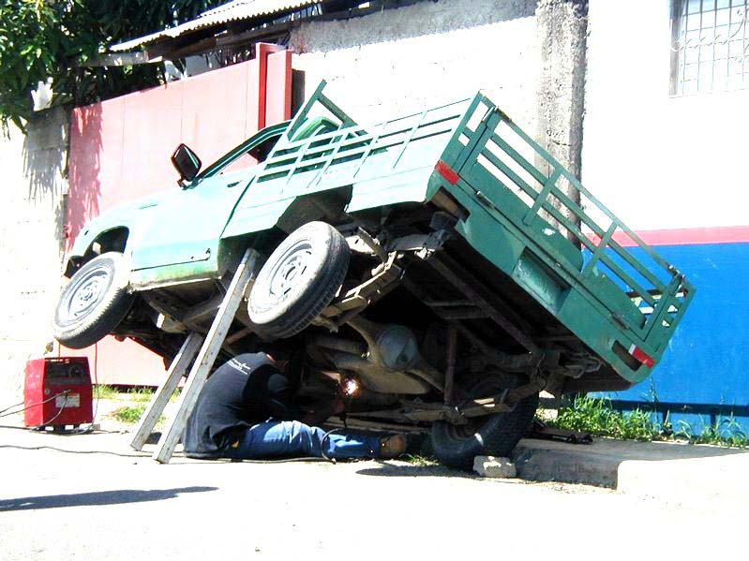
Securing loads while working under them…

Slide 20
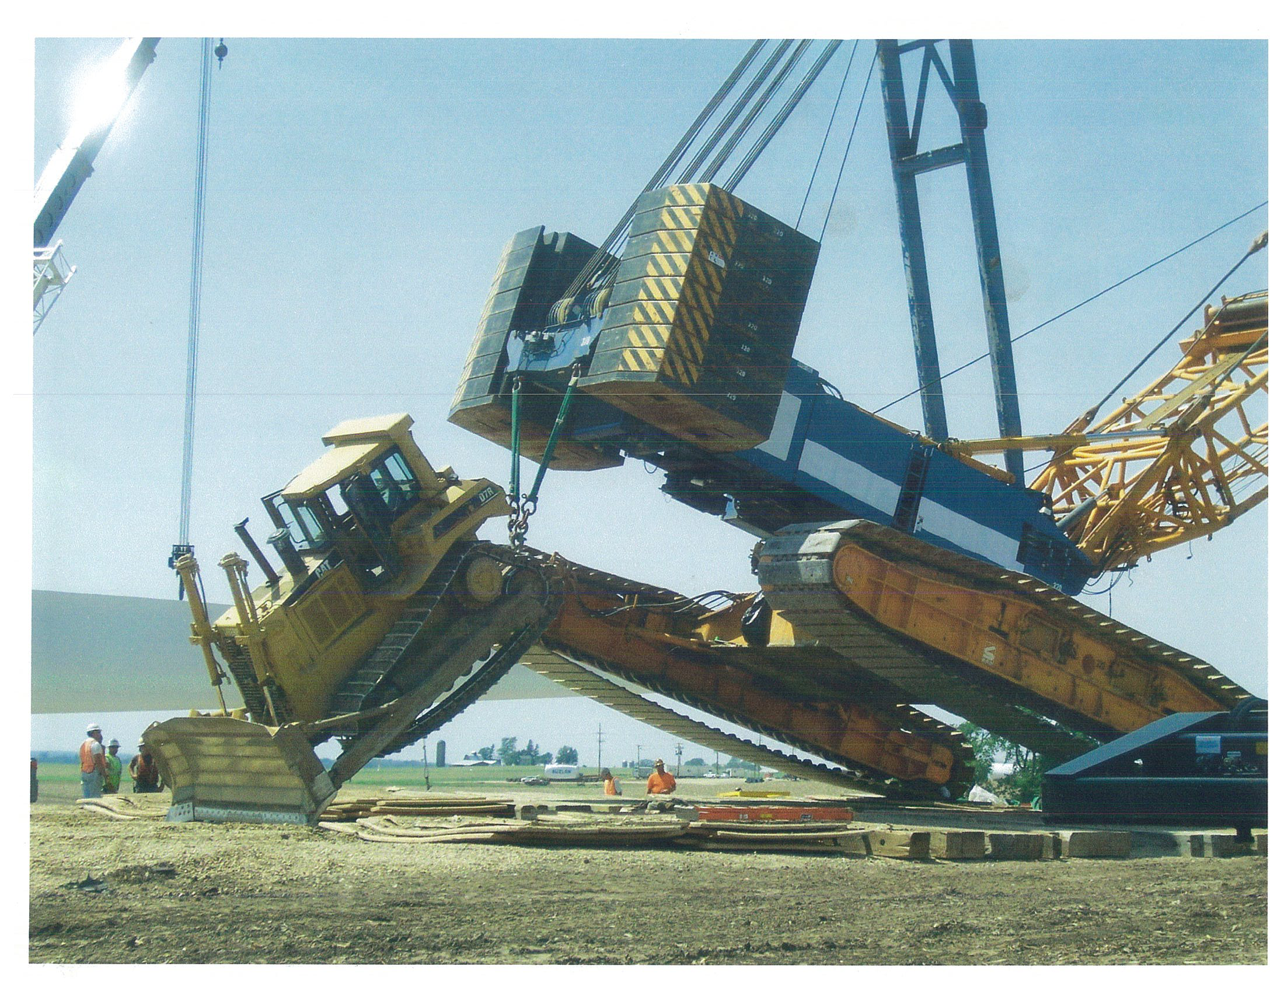

Slide 21
