Slide 1
Machine guarding

Slide 2
Introduction
Crushed hands and arms, severed fingers, blindness - the list of possible machinery-related injuries is as long as it is horrifying. Safeguards are essential for protecting workers from needless and preventable injuries.
A good rule to remember is: Any machine part, function, or process which may cause injury must be safeguarded.
Where the operation of a machine can injure the operator or other workers, the hazard must be controlled or eliminated.
Notes:
29 CFR 1910, Subpart O

Slide 3
Causes of Machine Accidents
Reaching in to “clear” equipment.
Not using Lockout/Tagout.
Unauthorized persons doing maintenance or using the machines.
Missing or loose machine guards.

Slide 4
Where Mechanical Hazards Occur
Point of operation.
All parts of the machine which move, such as:
Flywheels, pulleys, belts, couplings, chains, cranks, gears, etc.
Feed mechanisms and auxiliary parts of the machine
In-running nip points.
Notes:
All parts of the machine which move while the machine is working can cause mechanical hazards. These can include reciprocating, rotating, and transverse moving parts, as well as feed mechanisms and auxiliary parts of the machine.

Slide 5
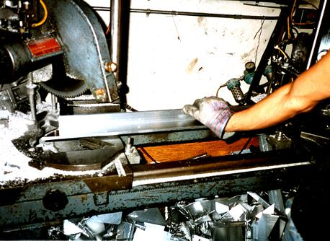
Point of Operation
That point where work is performed on the material, such as cutting, shaping, boring, or forming of stock must be guarded.
Notes:
1910.212(a)(3)(i) & (ii)

Slide 6
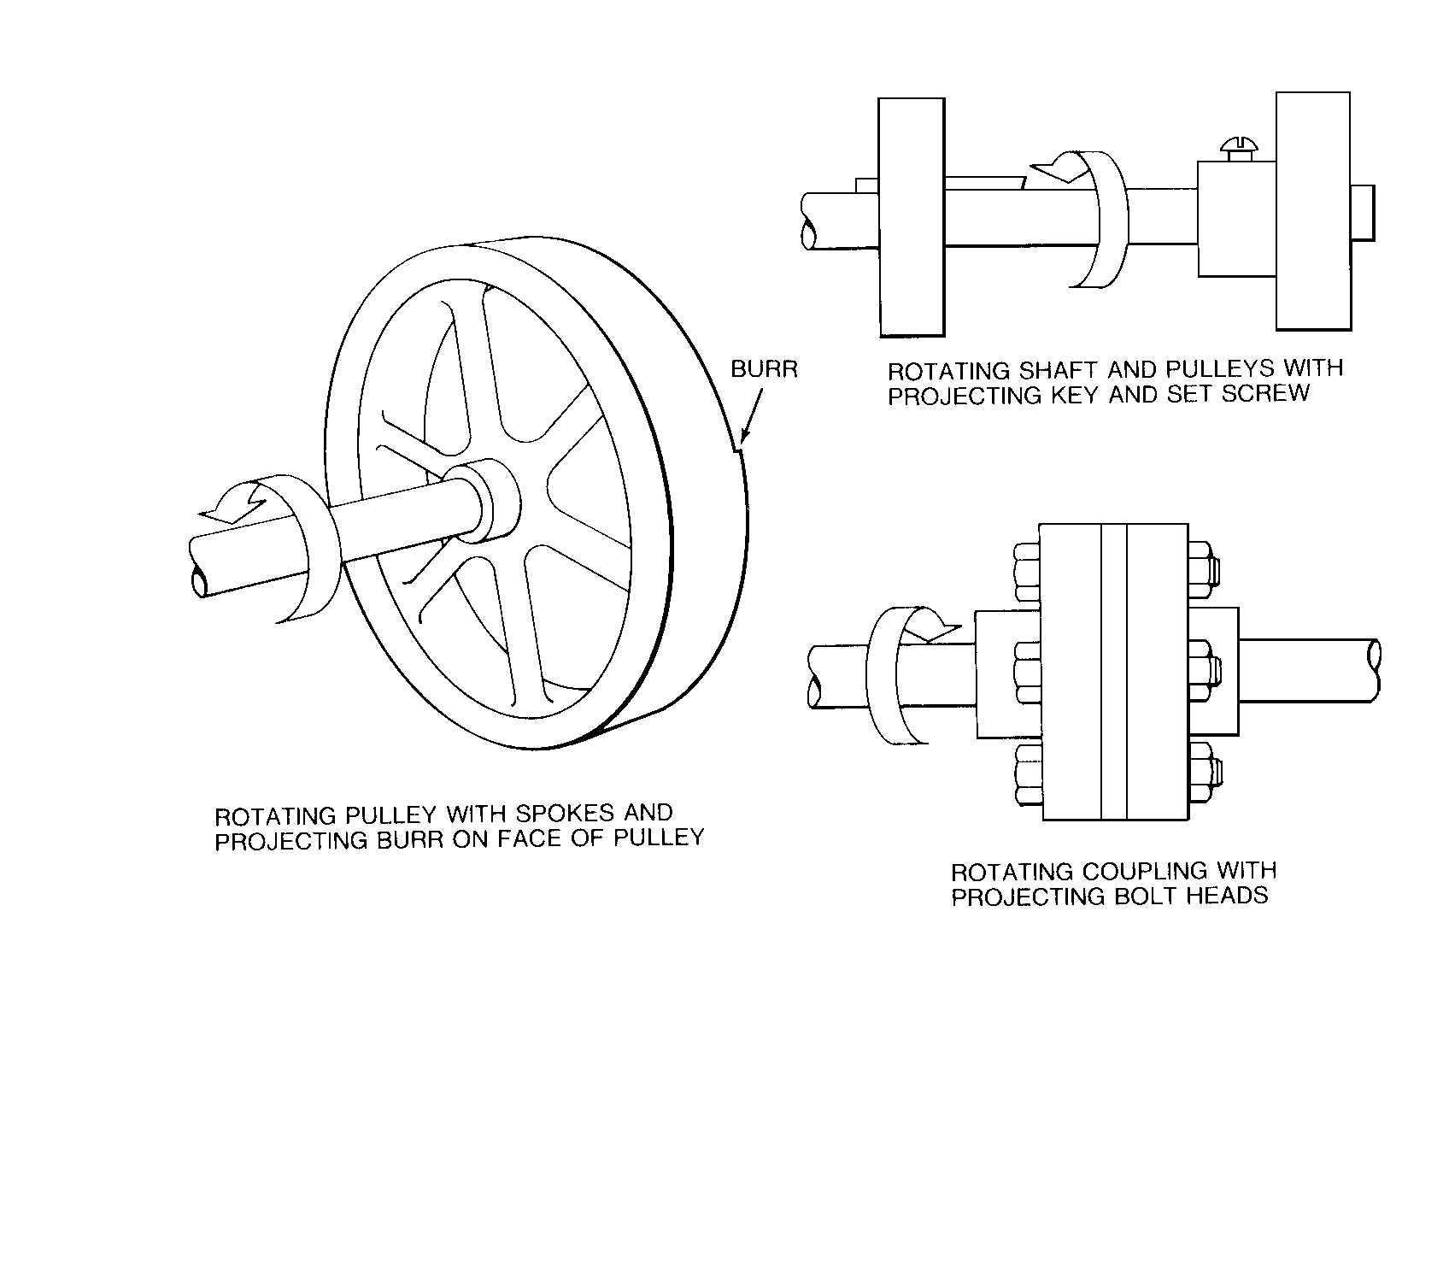
Rotating Parts

Slide 7
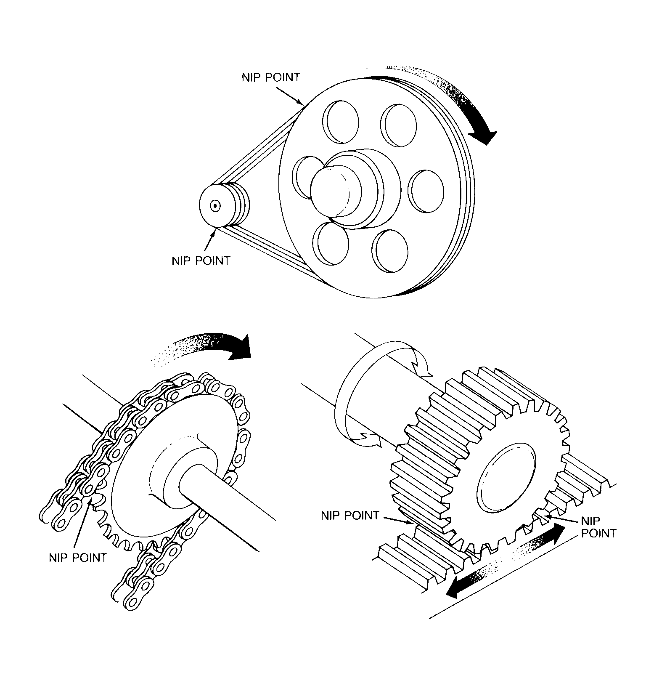
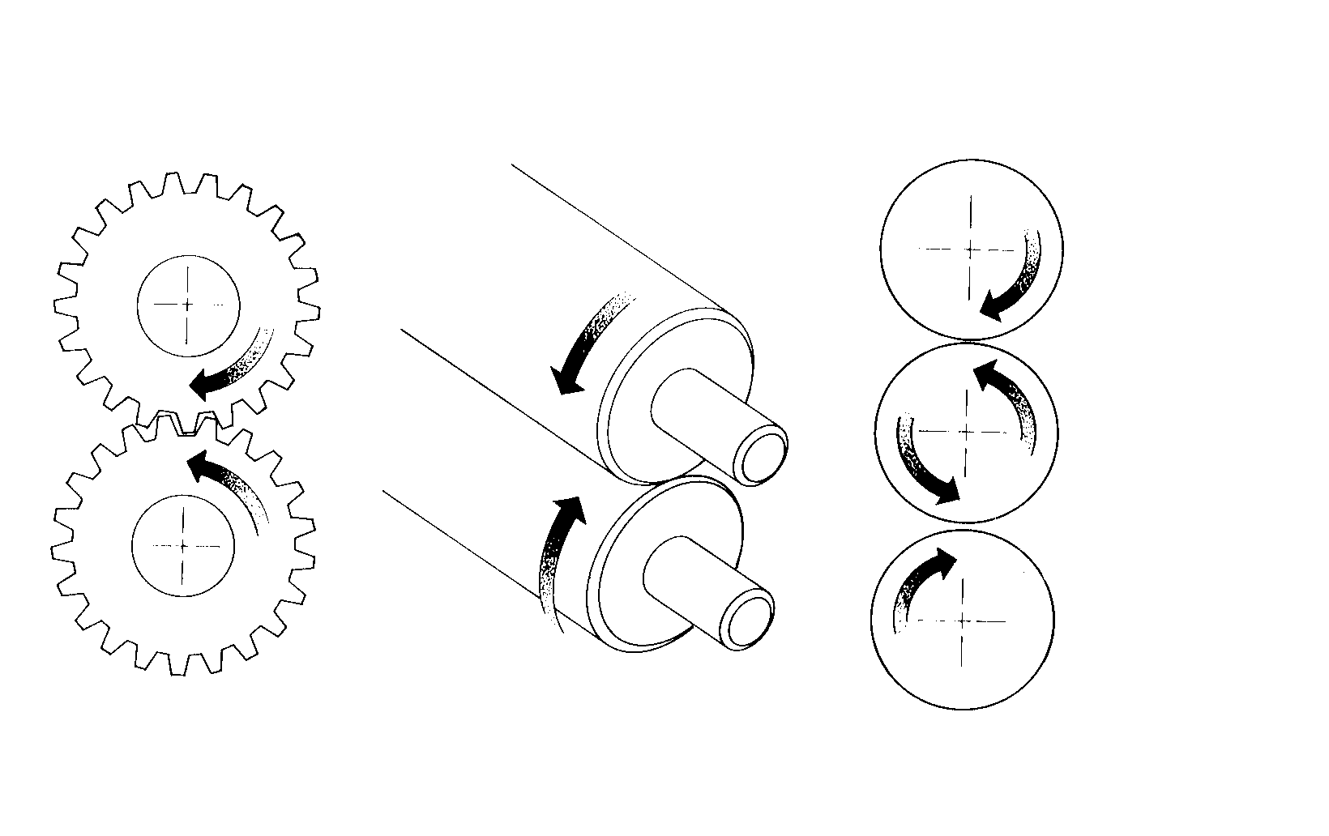
In-Running Nip Points
Belt & pulley
Rotating cylinders
Rack & pinion
Chain & sprocket
Notes:
In-running nip point hazards are caused by the rotating parts on machinery. There are three main types of in-running nips.
Parts can rotate in opposite directions while their axes are parallel to each other. These parts may be in contact (producing a nip point) or in close proximity to each other (where the stock fed between the rolls produces the nip points). This danger is common on machinery with intermeshing gears and rotating cylinders.
Another type of nip point is created between rotating and tangentially moving parts; for example, a chain and a sprocket, a rack and pinion, or the point of contact between a power transmission belt and its pulley.
Nip points can also occur between rotating and fixed parts which create a shearing, crushing, or abrading action; for example, spoked handwheels or flywheels, screw conveyors, or the periphery of an abrasive wheel and an incorrectly adjusted work rest.

Slide 8
Requirements for Safeguards
Prevent contact - prevent worker’s body or clothing from contacting hazardous moving parts.
Secure - firmly secured to machine and not easily removed.
Protect from falling objects - ensure that no objects can fall into moving parts.
Create no new hazards - must not have shear points, jagged edges or unfinished surfaces.
Create no interference - must not prevent worker from performing the job quickly and comfortably.
Allow safe lubrication - if possible, be able to lubricate the machine without removing the safeguards.
Notes:
Prevent Contact - A good safeguarding system eliminates the possibility of the operator or other workers placing parts of their bodies near hazardous moving parts.
Secure - A safeguard that can easily be made ineffective is no safeguard at all. Guards and safety devices should be made of durable material that will withstand the conditions of normal use and be firmly secured to the machine.
Protect from falling objects - A small tool which is dropped into a cycling machine could easily become a projectile that could strike and injure someone.
Create no new hazards - A safeguard defeats its own purpose if it creates a hazard of its own such as a shear point, a jagged edge, or an unfinished surface which can cause a laceration. The edges of guards, for instance, should be rolled or bolted in such a way that they eliminate sharp edges.
Create no interference - Any safeguard which impedes a worker from performing a job quickly and comfortably might soon be overridden or disregarded. Proper safeguarding can actually enhance efficiency since it can relieve the worker’s apprehensions about injury.
Allow safe lubrication - Locating oil reservoirs outside the guard, with a line leading to the lubrication point, will reduce the need for the worker to enter the hazardous area.

Slide 9
Methods of Machine Safeguarding
Guards
Fixed
Interlocked
Adjustable
Self-adjusting
Devices
Presence sensing
Pullback
Restraint
Safety controls (tripwire cable, two-hand control, etc.)
Gates
Location/distance
Feeding and ejection methods
Automatic and/or semi-automatic feed and ejection
Robots
Miscellaneous aids
Awareness barriers
Protective shields
Hand-feeding tools

Slide 10
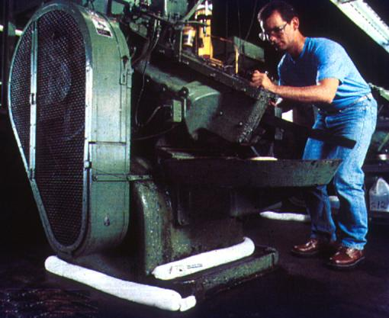
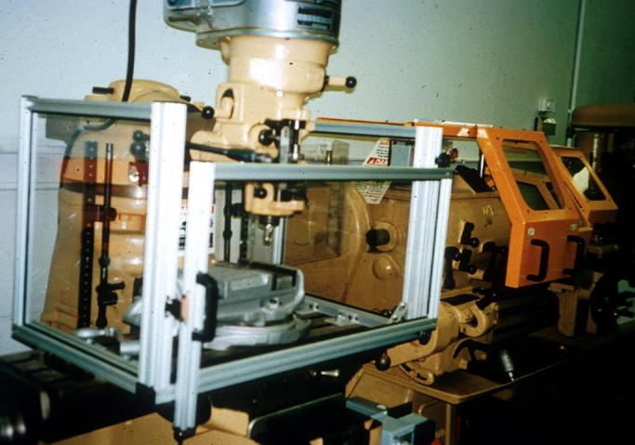
Fixed Guard
Provides a barrier - a permanent part of the machine, preferable to all other types of guards.
Notes:
1910.212(a)(2)
As a general rule, power-transmission apparatus is best protected by fixed guards that enclose the danger area. For hazards at the point of operation, where moving parts actually perform work on stock, several kinds of safeguarding are possible.

Slide 11
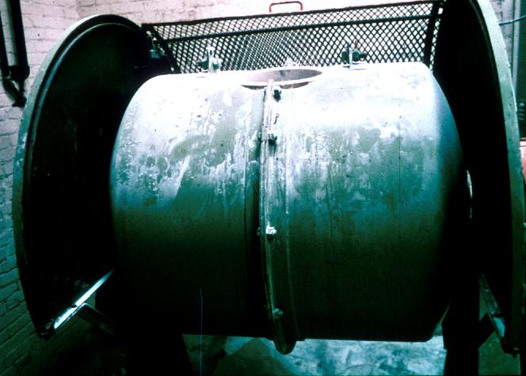
Interlocked Guard
When this type of guard is opened or removed, the tripping mechanism and/or power automatically shuts off or disengages, and the machine cannot cycle or be started until the guard is back in place.
Interlocked guard on revolving drum
Notes:
An interlocked guard may use electrical, mechanical, hydraulic, or pneumatic power or any combination of these. Interlocks should not prevent “inching” by remote control, if required. Replacing the guard should not automatically restart the machine.

Slide 12
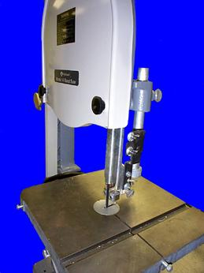
Adjustable Guard
Provides a barrier which may be adjusted to facilitate a variety of production operations.
Band saw blade adjustable guard
Notes:
Adjustable guards are useful because they allow flexibility in accommodating various sizes of stock, but, because they require adjusting, they are subject to human error.

Slide 13
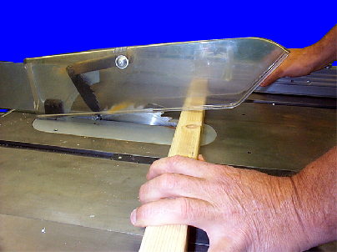
Self-Adjusting Guard
Provides a barrier which moves according to the size of the stock entering the danger area.
Circular table saw self-adjusting guard
Notes:
Self-adjusting guards avoid the potential for human error associated with adjustable guards.

Slide 14
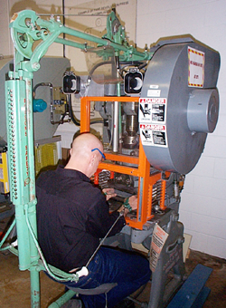
Pullback Device
Utilizes a series of cables attached to the operator’s hands, wrists, and/or arms.
Primarily used on machines with stroking action.
Allows access to the point of operation when the slide/ram is up.
Withdraws hands when the slide/ram begins to descend.

Slide 15
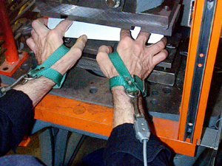
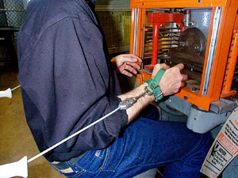
Pullback Device (cont’d)
Hands in die, feeding.
Point of operation exposed.
Pullback device attached and properly adjusted.
Die closed.
Hands withdrawn from point of operation by pullback device.

Slide 16
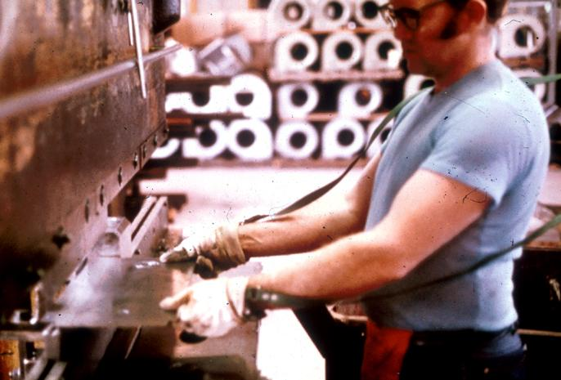
Restraint Device
Uses cables or straps attached to the operator’s hands and a fixed point.
Must be adjusted to let the operator’s hands travel within a predetermined safe area.
Hand-feeding tools are often necessary if the operation involves placing material into the danger area.

Slide 17
Safety Tripwire Cables
Device located around the perimeter of or near the danger area.
Operator must be able to reach the cable to stop the machine.
Notes:
Tripwire cables must be manually reset to restart the machine.

Slide 18
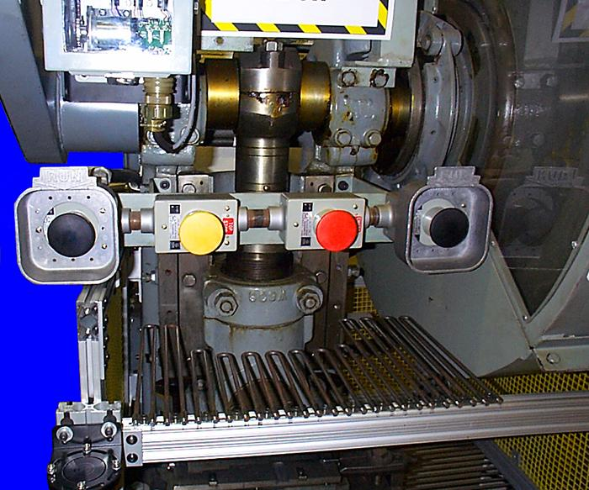
Two-Hand Control
Requires constant, concurrent pressure to activate the machine.
The operator’s hands are required to be at a safe location (on control buttons) and at a safe distance from the danger area while the machine completes its closing cycle.
.
Notes:
This kind of control requires a part-revolution clutch, brake, and brake monitor if used on a power press as shown.
A similar device, known as a two-hand trip, requires concurrent application of both of the operator’s control buttons to activate the machine cycle, after which the hands are free. This device is used with machines equipped with full-revolution clutches. The trips must be placed far enough from the point of operation to make it impossible for the operators to move their hands from the trip buttons or handles into the point of operation before the first half of the cycle is completed to prevent them from being accidentally placed in the danger area prior to the slide/ram or blade reaching the full “down” position.

Slide 19
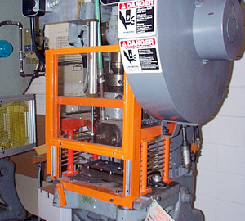
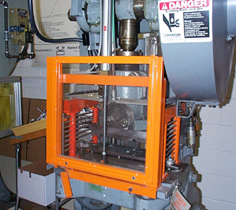
Gate
Movable barrier device which protects the operator at the point of operation before the machine cycle can be started.
If the gate does not fully close, machine will not function.
Gate Open
Gate Closed
Notes:
Another potential application of this type of device is where the gate is a component of a perimeter safeguarding system. Here the gate may provide protection not only to the operator but to pedestrian traffic as well.

Slide 20
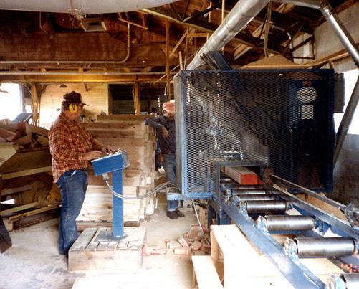
Safeguarding by Location/Distance
Locate the machine or its dangerous moving parts so that they are not accessible or do not present a hazard to a worker during normal operation.
Maintain a safe distance from the danger area.
Notes:
One approach to safeguarding by location is shown in this photo. Operator controls may be located at a safe distance from the machine if there is no reason for the operator to tend it.
Another approach is to locate the machine so that a plant design feature, such as a wall, protects the worker and other personnel. Enclosure walls or fences can also restrict access to machines. Another possible solution is to have dangerous parts located high enough to be out of the normal reach of any worker.

Slide 21
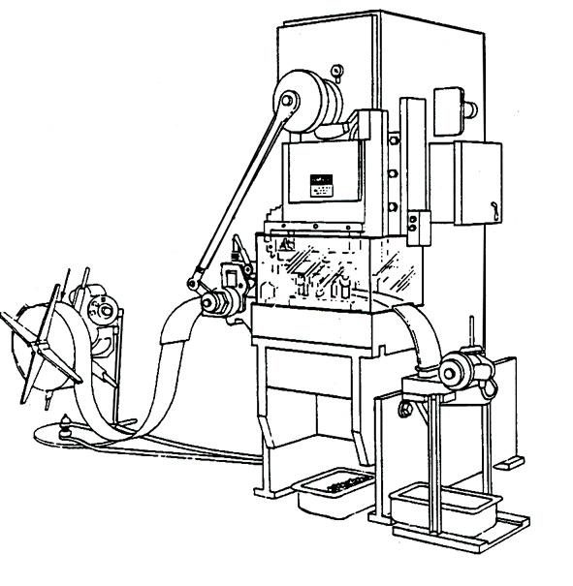
Automatic Feed (shown on power press)
Transparent
Enclosure
Guard
Stock Feed
Roll
Danger
Area
Completed Work
Notes:
Many feeding and ejection methods do not require operators to place their hands in the danger area. In some cases, no operator involvement is necessary after the machine is set up. In other situations, operators can manually feed the stock with the assistance of a feeding mechanism. Properly designed ejection methods do not require operator involvement after the machine starts to function.
Using feeding and ejection methods does not eliminate the need for safeguarding. Guards and other devices must be used wherever they are necessary to provide protection from hazards.
Automatic feeds reduce the operator exposure during the work process, and sometimes do not require any effort by the operator after the machine is set up and running.
The power press shown in the photo above has an automatic feeding mechanism. Notice the transparent fixed enclosure guard at the danger area.

Slide 22
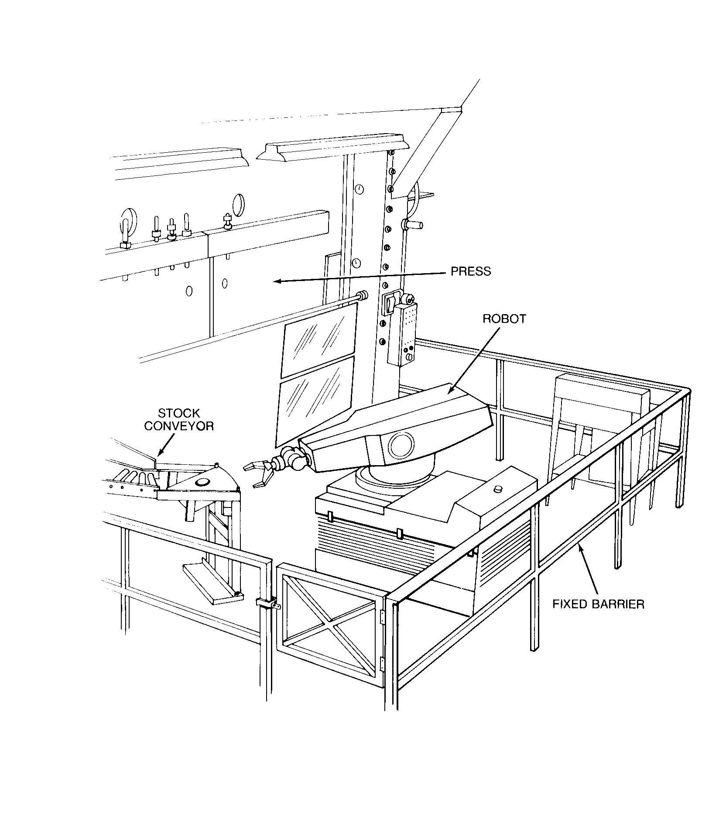
Robots
Machines that load and unload stock, assemble parts, transfer objects, or perform other tasks.
Best used in high-production processes requiring repeated routines where they prevent other hazards to employees.
Notes:
Robots may create hazards themselves. If they do, appropriate guards must be used. The most common technique is to use perimeter guarding with interlocked gates.
The American National Standards Institute (ANSI) safety standard for industrial robots, ANSI/RIA R15.06-1999, presents certain basic requirements for protecting the worker. However, when a robot is used in a workplace, the employer should accomplish a comprehensive operational safety and health hazard analysis and then implement an effective safeguarding system which is fully responsive to the situation. [Various effective safeguarding techniques are described in ANSI B11.19-1990 (R1997).]
Studies in Sweden and Japan indicate that many robot accidents did not occur under normal operating conditions, but rather during programming, program touch-up, maintenance, repair, testing, setup, or adjustment. During these operations, workers may temporarily be within the robot’s working envelope where unintended operation could result in injuries.

Slide 23
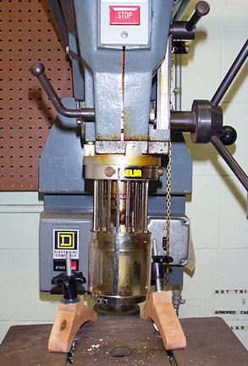
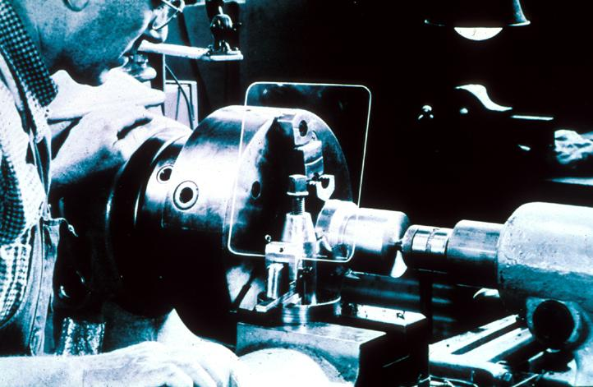
Protective Shields
These do not give complete protection from machine hazards, but do provide some protection from flying particles, splashing cutting oils, or coolants.
Notes:
Miscellaneous aids, such as these, do not give complete protection from machine hazards, but may provide the operator with an extra margin of safety.

Slide 24
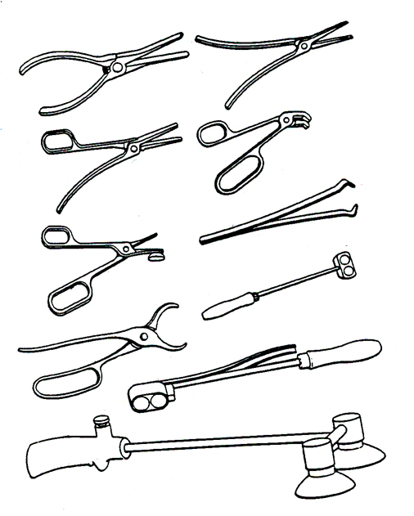
Holding Tools
Used to place and remove stock in the danger area.
Not to be used instead of other machine safeguards, but as a supplement.
Notes:
1910.212(a)(3)(iii)

Slide 25
Some Examples of OSHA Machine Guarding Requirements . . . .

Slide 26
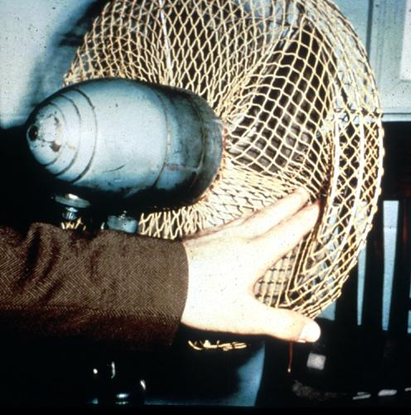
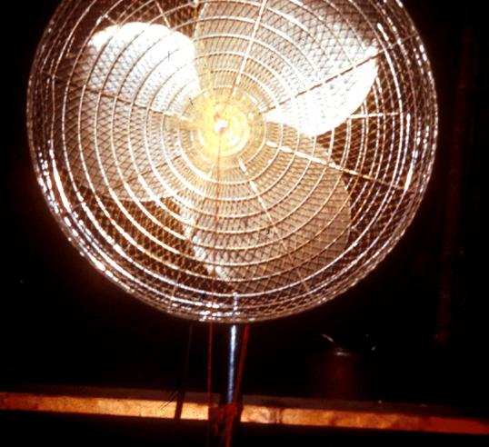
Guarding Fan Blades
When the periphery of the blades of a fan is less than 7 feet above the floor or working level, the blades must be guarded with a guard having openings no larger than 1/2 inch.
Notes:
1910.212(a)(5)

Slide 27
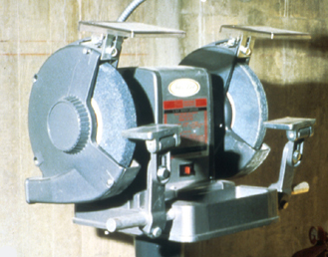
Abrasive Wheel Machinery
Work rests on offhand grinding machines must be kept adjusted closely to the wheel with a maximum opening of 1/8-inch to prevent the work from being jammed between the wheel and the rest, which may result in wheel breakage.
Notes:
1910.215(a)(4)

Slide 28
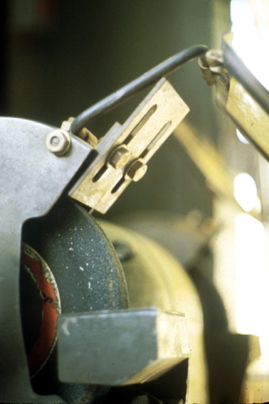
Abrasive Wheel Machinery
The distance between the wheel periphery and the adjustable tongue must never exceed 1/4-inch.
Notes:
1910.215(b)(9)

Slide 29
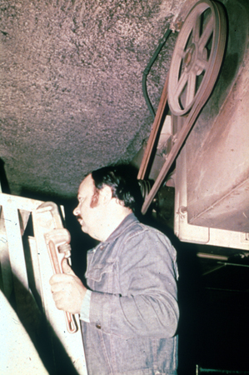
Power-Transmission Apparatus
Unguarded belt
& pulley
Power-transmission apparatus (shafting, flywheels, pulleys, belts, chain drives, etc.) less than 7 feet from the floor or working platform must be guarded.
Notes:
1910.219

Slide 30
Machine Safety Responsibilities
Management
Ensure all machinery is properly guarded.
Supervisors
Train employees on specific guard rules in their areas.
Ensure machine guards remain in place and are functional.
Immediately correct machine guard deficiencies.
Employees
Do not remove guards unless machine is locked and tagged.
Report machine guard problems to supervisors immediately.
Do not operate equipment unless guards are in place.

Slide 31
Training
Operators should receive training on the following:
Hazards associated with particular machines.
How the safeguards provide protection and the hazards for which they are intended.
How and why to use the safeguards.
How and when safeguards can be removed and by whom.
What to do if a safeguard is damaged, missing, or unable to provide adequate protection.

Slide 32
Summary
Safeguards are essential for protecting workers from needless and preventable machinery-related injuries.
The point of operation, as well as all parts of the machine that move while the machine is working, must be safeguarded.
A good rule to remember is: Any machine part, function, or process which may cause injury must be safeguarded.
Notes:
For more information on this subject, see the following OSHA publication available at www.osha.gov:
Concepts and Techniques of Machine Guarding – OSHA 3067

