Slide 1
OSHA Inspections - How to Prepare and Handle Them

Slide 2
What was safety like before OSHA?

Slide 3
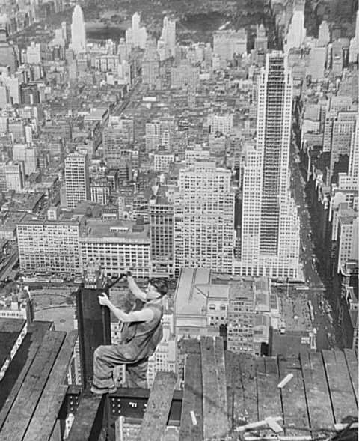

Slide 4
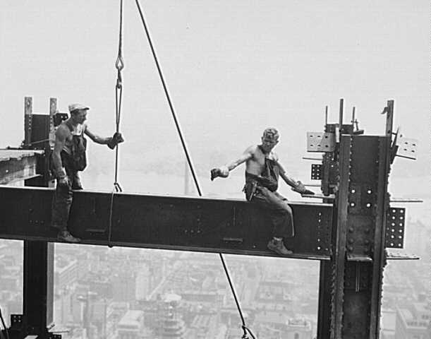

Slide 5
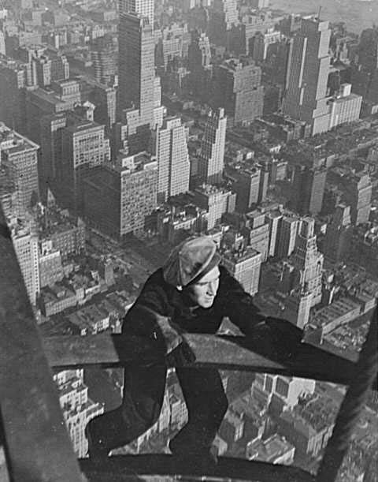

Slide 6
In very early 1970
OSHA is born…

Slide 7
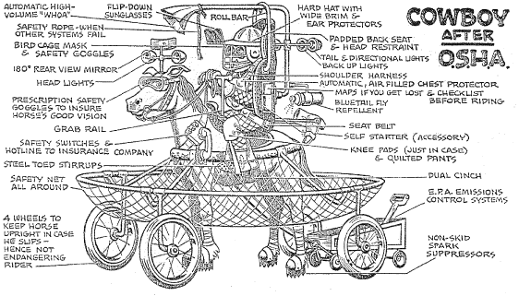
And the Humor Begins…

Slide 8
Top ten list of how you can tell if your osha inspection is going poorly
OSHA sets up temporary housing in your parking lot.
The Compliance Officer mutters, "This is unbelievable" each time he or she enters a different department.
OSHA calls in a professional film crew to document conditions in the plant. A reporter from "60 Minutes" tags along.
The Compliance Officer insists on wearing a moon suit supplied with a SCBA, while your employees work in jeans and tennis shoes.
The Congressman you called for help won't return your call, but he does return your campaign contribution.

Slide 9
Top ten list of how you can tell if your osha inspection is going poorly (Continued)
The Compliance Officer beings the opening conference with the following…"You have the right to remain silent"
The Compliance Officer asks you a specific question about a report in your files, but you haven't turned over any files.
The Compliance Officer knows each of your employees by their first name.
The Compliance Officer is a former employee that you fired.
The current OSHA secretary conducts the closing conference.

Slide 10
We have gone from building fatalities into the cost of constructing buildings To hundreds of thousands of hours worked without a lost time accident!
WHY?

Slide 11
What is the best Way to Prepare for an OSHA inspection?

Slide 12
Right!
Be in compliance!

Slide 13
Have a Plan!
Written procedure:
  Actions taken, personnel to be notified, credentials, sign in, orientation etc.
  All locations should have this document.
  Place it on the company intranet.
  What does your Jobsite look like? First impressions are lasting.

Slide 14
The Interaction
Per 29 CFR 1903.7(a) request:
  The inspectors I.D. # and record this.
  Name and address of area director.
  Nature of the inspection:
    Complaint, random, planned, program, referral etc.
    Now you have a choice to make.

Slide 15
Your Decision
Let them in or get a warrant?
Pros and cons?

Slide 16
The Scope
Random:
  What is the extent?
  Is it focused on a specific process or area?
  IH?
  Records?
Complaint:
  If they are there, you can assume that there is a signed, valid complaint. (fax would be sent if not signed)

Slide 17
The Scope (Continued)
Referral:
  Usually, a specific area.
Programmed/planned/follow-up:
  Usually specific.
Wall to walls are usually reserved for the willful repeats and the bad actors!

Slide 18
The Process
Opening conference and Records check.
Programs
Training
Documentations
Inspections/Walk through
Interviews
Closing conference
Love Letter

Slide 19
Your Attitude Counts!
Been involved with 100’s of inspections.
Push/Push back.
Correct on the spot.
Send proof of correction ASAP.
Communicate
Ask questions.

Slide 20
After the Citation
Correct everything ASAP.
Take Photos.
Request An Informal Conference.
Plead your case (citation reductions).
Appeal (may need legal council).
Maintain compliance.

Slide 21
The Follow-Up
OSHA may return to verify compliance!
Repeat violations can be costly!
Walk the talk.
Employee enforcement.
Outside resources.

Slide 22
In Closing
Master the basics.
Keep meticulous records.
Know your data.
Hold regular employee training/sign offs.
Regular inspections/corrections.
Have a plan!

