Slide 1
Osha recordkeeping
Revised Recordkeeping rule published in the Federal Register on January 19, 2001
Affects 1.4 million establishments
Scheduled to become effective on January 1, 2002

Slide 2
Rule Changes include
Increases employee involvement.
Creates simpler forms.
Provides clearer regulatory requirements.
Increases employers’ flexibility to use computers.

Slide 3
Forms
Updates three recordkeeping forms:
OSHA Form 300 – Log of Work-Related Injuries and Illnesses.
OSHA Form 301 – Injury and Illness Incident Report.
OSHA Form 300A – Summary of Work-Related Injuries and Illnesses.
1904.29

Slide 4
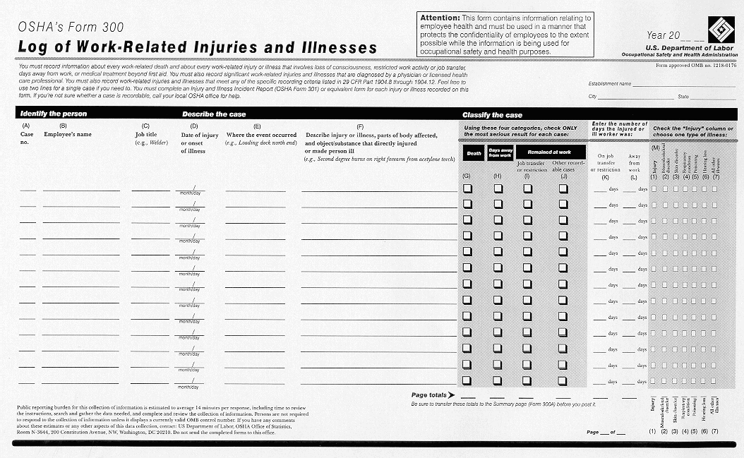
OSHA Form 300

Slide 5
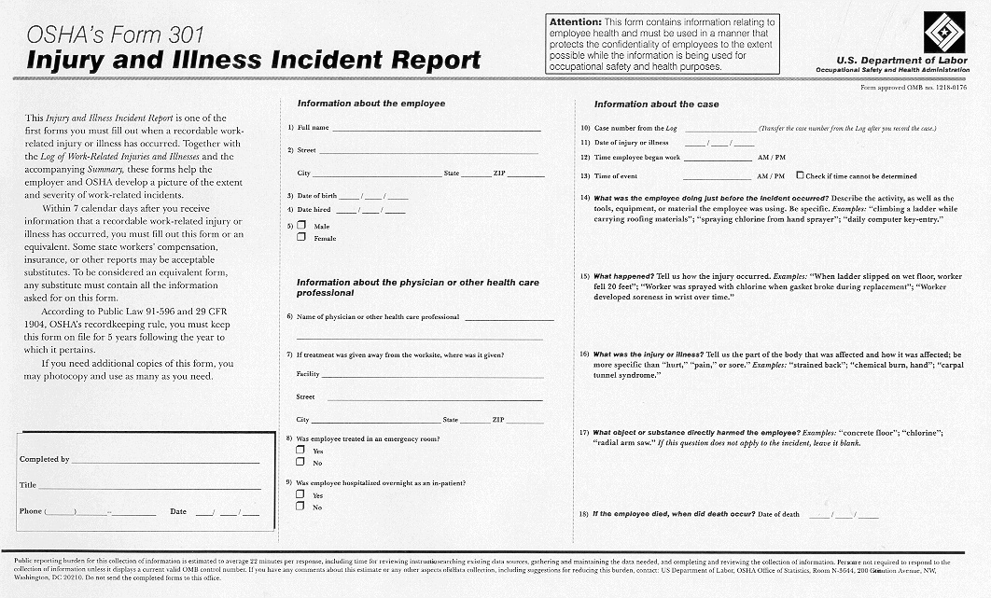
OSHA Form 301

Slide 6
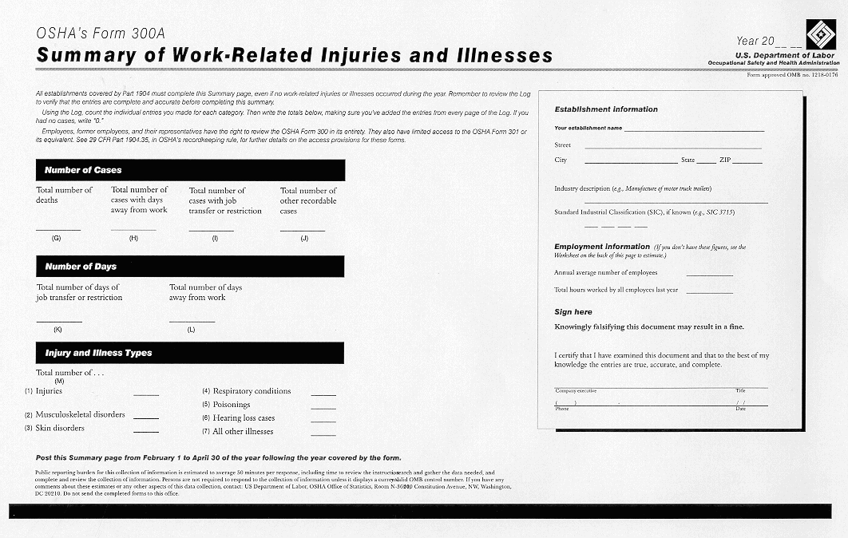
OSHA Form 300A

Slide 7
Recording Criteria
Eliminates different criteria for recording work-related injuries and work-related illnesses.
Former rule required employers to record all illnesses, regardless of severity.
1904.4

Slide 8
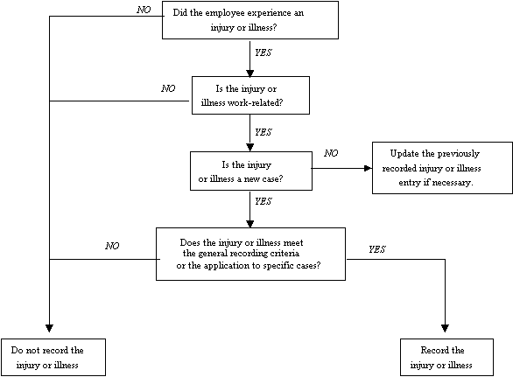
Recording Criteria Decision Tree
1904.4
Notes:
Follow the flowchart with handout
Specific cases refers to 1904.8 through 1904.11

Slide 9
Work-Relatedness
Cases are work-related if:
An event or exposure in the work environment either caused or contributed to the resulting condition.
An event or exposure in the work environment significantly aggravated a pre-existing injury or illness.
1904.5
Notes:
Page 5946.

Slide 10
Work-Related Exceptions
Adds additional exceptions to the definition of work relationship to limit recording of cases involving:
The eating and drinking of food and beverages
Common colds and flu
Blood donations
Exercise programs
Mental illnesses
1904.5(b)(2)

Slide 11
General Recording Criteria
Requires records to include any work-related injury or illness resulting in one of the following:
Death
Days away from work
Restricted work or transfer to another job
Medical treatment beyond first aid
Loss of consciousness
Diagnosis of a significant injury/illness by a physician or other licensed health care professional
1904.7(a)

Slide 12
General Recording Criteria (continued)
Includes new definitions of medical treatment and first aid to simplify recording decisions.
Clarifies the recording of “light duty” or restricted work cases.
1904.7(b)(5)

Slide 13
Recording Needle sticks
Requires employers to record all needle stick and sharps injuries involving contamination by another person’s blood or other potentially infectious material.
1904.8

Slide 14
Hearing Loss
Requires employers to record standard threshold shifts (STS) in employees’ hearing.
Provides a separate column on the OSHA Form 300 to capture statistics on hearing loss.
1904.10
***OSHA has delayed this provision and the separate hearing loss column on the OSHA forms until 1/1/2003.

Slide 15
Musculoskeletal Disorders
Applies the same recording criteria to musculoskeletal disorders (MSDs) as to all other injuries and illnesses.
Employer retains flexibility to determine whether an event or exposure in the work environment caused or contributed to the MSD.
Forms include columns dedicated to MSD cases.
1904.12
***OSHA has delayed the definition of an MSD and the separate MSD column on the OSHA forms until 1/1/2003.

Slide 16
Tuberculosis
Includes separate provisions describing the recording criteria for cases involving the work-related transmission of tuberculosis or medical removal under OSHA standards.
1904.11

Slide 17
Day Counts
Eliminates the term “lost workdays” and focuses on days away or days restricted or transferred.
Includes new rules for counting that rely on calendar days instead of workdays.
1904.7(b)(3)

Slide 18
Employee Involvement
Requires employers to establish a procedure for employees to report injuries and illnesses and tell their employees how to report.
Employers are prohibited from discriminating against employees who do report.
Employee representatives will now have access to those parts of the OSHA 301 form relevant to workplace safety and health.
1904.35 & 36

Slide 19
Employee Privacy
Prohibits employers from entering an individual’s name on Form 300 for certain types of injuries/illnesses.
Provides employers the right not to describe the nature of sensitive injuries where the employee’s identity would be known.
Gives employee representatives access only to the portion of Form 301 which contains no personal information.
Requires employers to remove employees’ names before providing the data to persons not provided access rights under the rule.
1904.29(b)

Slide 20
Annual Summary
Requires the annual summary to be posted for three months instead of one.
Requires certification of the summary by a company executive.
1904.32

Slide 21
Reporting to OSHA
Changes the reporting of fatalities and catastrophes to exclude some public transportation and motor vehicle accidents.
1904.39

