Slide 1
Roofing fall protection

Slide 2
Topics covered
Fall arrest equipment.
Inspection and maintenance of fall protection equipment.
Rescuing a fallen co-worker.
The fall protection work plan.
Notes:
“These are the topics that WISHA says we must cover in training our employees who use fall protection.”

Slide 3
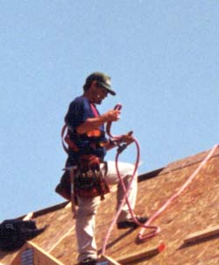
Fall Arrest
Fall Arrest – type used in roofing
  Personal Fall Arrest – full body harness is the most common.

Slide 4
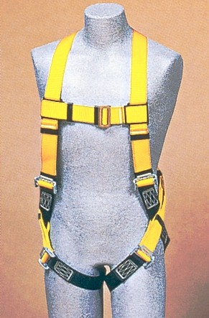
Fall Arrest Equipment
Personal Fall Arrest:
  A full body harness is a common fall arrest system used in roofing.
  A full body harness stops a fall in progress and minimizes the force of the fall to your body.
  Waist belts not allowed because a fall will usually result in injury.

Slide 5
Fall Arrest Equipment
Full Body Harness
  The attachment point on a full body harness is a D-ring on your upper back.
  It must be an commercial ANSI Class III harness. Recreational climbing harness are not allowed.
  Be sure to use a size that fits you properly.

Slide 6
Fall Arrest Equipment
Why Waist Belts Are Not Safe…
If you fall, the high force of the fall is concentrated at your waist rather than the 6 points of a full body harness.
Notes:
“ A fall with a waist belt on will usually cause internal injuries. A heavy person will probably tip over and fall head-first out of the waist belt in a fall.”

Slide 7
Fall Arrest Equipment
Some fall arrest gear comes with a shock-absorbing lanyard.
Must be adjusted to prevent hitting ground or lower level.
In a fall, the equipment stretches several feet.
Notes:
“Some lanyards are self-retracting.”

Slide 8
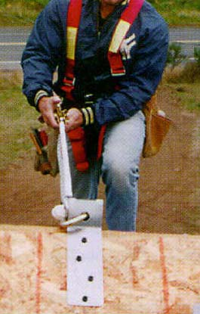
Anchors
Fall arrest equipment is only as good as the anchor:
  An anchor must be able to withstand 5000 lbs. of force without failing.
  Manufactured anchors must be installed according to manufacturer’s instructions.
  Check pre-installed anchors before using.
  In a fall, your life depends on the anchor holding.
Notes:
“ 5000 pounds is the weight of a mid-size pickup truck. When you install an anchor or decide to use an existing one, keep in mind that that anchor must hold the equivalent of a pickup truck. Eyebolts are not recommended since they can pull out too easily under high forces.”

Slide 9
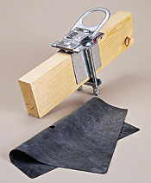
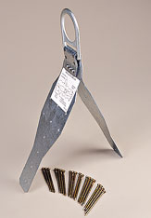
Anchor Strength
These commercial anchors will support 5000 pounds when installed according to manufacturer’s instructions.
But, what about knots tied to buildings?

Slide 10
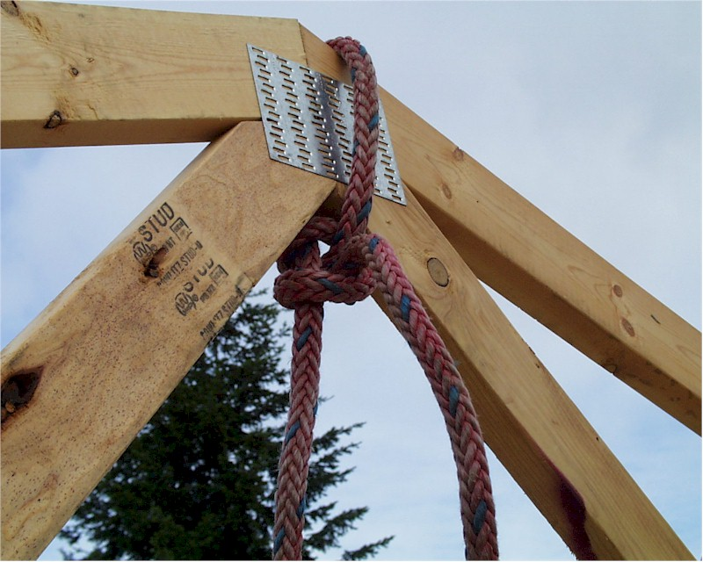
Knots and Anchor Points
Truss peak used as anchor point
A knot can be used to secure a lifeline to an anchor point only when:
  You know the breaking strength of the lifeline.
  The knot does not decrease the strength of the lifeline below 5000 lbs.
Notes:
“This kind of anchor can be used on trusses, provide the conditions mentioned are met. This picture shows a double half-hitch or round turn which reduces the strength of the rope by 30-35%.”

Slide 11
Knots and Anchor Points
Rope-Breaking Strength
Material Diameter | Manila | Polypro | Dacron | Nylon
5/8 in. | 3470 | 4858 | 6940 | 8675
17 mm | 3987 | 5882 | 7974 | 9967
18 mm | 4477 | 6268 | 8954 | 11,192
¾ in. 19 mm | 4997 | 6996 | 9994 | 12,492
Notes:
“ This chart shows the breaking strength in pounds of different kinds of life-line rope.”

Slide 12
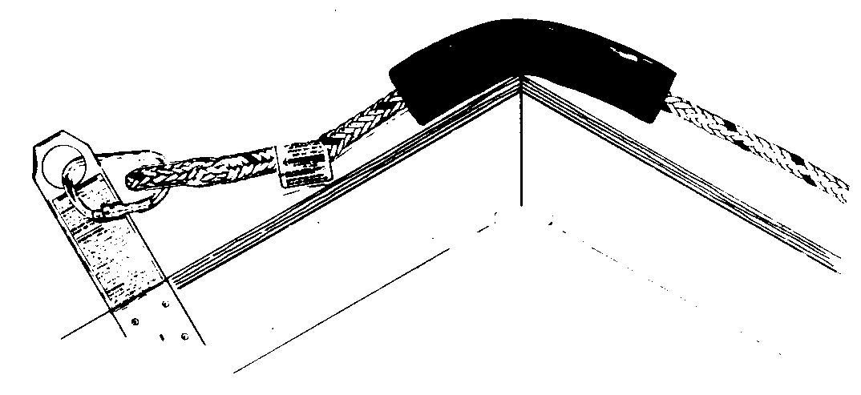
Fall Arrest Equipment Use
Protect rope or lanyard from sharp edges.
Knots in ropes or lanyard can reduce strength by as much as 50%.
Notes:
“ Knots are not prohibited, but they must not reduce the strength of the rope below 5000 pounds.”

Slide 13
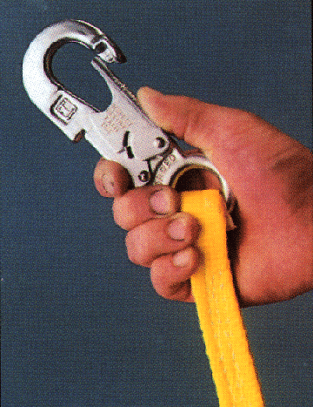

Fall Arrest Equipment Use
Snap hooks:
  Must be locking type.
  Never hook two snap hooks together.
Notes:
“Snap hooks must also have minimum breaking strength of 5000 pounds.”

Slide 14
Fall Arrest Equipment Use
Some Equipment Do’s and Don’ts:
  Do inspect for wear and damage before use.
  Do remove from service after a fall for inspection.
  Don’t use to lift materials.
  Don’t attach to guardrails or hoists.
Notes:
“ Don’t attach to hoist unless you are using the hoist to gain access to the roof.”

Slide 15
Fall Arrest Equipment Use
Fall Arrest Gear Inspection
Look for the following:
  Webbing - Cuts, tears, abrasion, fraying, stretching, mold, chemical damage.
  D-rings - Cracks, breaks corrosion, rough edges.
  Tongue-buckle - Distortions, added holes, broken grommets.
  Ropes - Abrasion, internal damage.
Notes:
[Inspection of employees’ personal fall arrest equipment can be done here.]

Slide 16
Handling Tools & Materials
Describe here your procedures for handling, storing and securing tools and materials at the jobsite.

Slide 17

Overhead Protection
Describe how will you protect any employees working or passing through area below roof from overhead items dropping on them such as:
  Hard hats
  Warning signs
  Warning line designating a material
  handling area
  Toe boards on walkways and decks

Slide 18
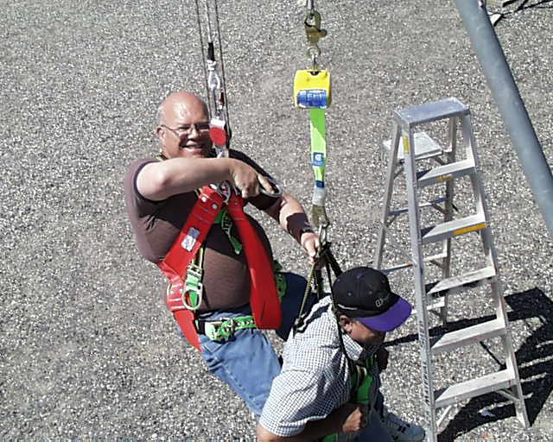
Fall Protection Rescue
Describe rescue methods here – self-rescue or assisted rescue using ladders, aerial lifts, forklifts, etc. Also describe first aid measures for injured fallen worker, and how will get medical treatment.
Notes:
[Calling 911 in some areas does not ensure prompt rescue since some 911 responders are not equipped or trained to rescue an injured worker suspended from a building.]

Slide 19
Fall Protection Plan
Fall Protection Plan For Every Job
We are required to prepare a fall protection plan for every job.
Be prepared to go over this plan with your crew boss or lead worker at the beginning of every roofing job.
Notes:
[You can show an example of a fall protection plan from previous jobs here.]

Slide 20
Notes:
“New York City in the 1930’s. Is there a net down there somewhere?”

