Slide 1
Roofing safety
One Step at a Time

Slide 2
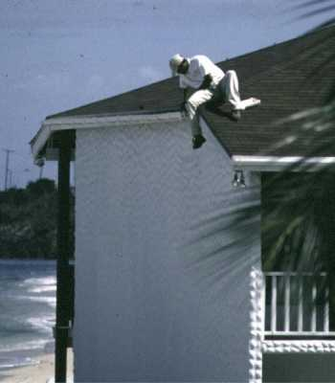
The Facts
Falls are not only the most common injuries associated with roofing, they are the most serious.
About 30% - 40% of worker fatalities are due to falls.

Slide 3
Recognizing Safety Hazards
Roofing Work Sites Continually Change – Some roofs may have skylights that need to be guarded.
Materials Often Vary – Work practices and procedures change especially when dealing with toxic and flammable solvents.
Changes in Weather – Be aware of weather patterns to avoid getting caught in it.

Slide 4
Weather Case #1
Employee #1 (the employer) and his two man crew were finishing the framing on a second story roof.
Without warning, a thunderstorm with winds of 70 mph blew the entire structure upward and then back down.
Second floor collapsed, crushing and killing employee #1 between the ground floor and the wooden substructure.

Slide 5
OSHA Regulations
Low Slope Roofs – A roof having a slope less than or equal to 4:12.
Steep Roofs – A roof having a slope greater than 4:12.
Safety Monitoring System - The employer designates a competent person to monitor workers’ safety and warn them of any fall hazards.

Slide 6
Low Slope Roof - Regulations
A fall protection system or a combination of systems must be in place with unprotected sides and edges 6 feet or more from lower levels.
EX: Guardrails, Safety Nets, or a combination of Warning Line and Safety Monitoring Systems.
On roofs 50 feet or less in width, the use of a Safety Monitoring System without a Warning Line is permitted.

Slide 7
Steep Roof - Regulations
Each employee on a steep roof with unprotected sides and edges 6 feet or more above lower levels shall be protected from falling by:
Guardrail Systems with Toeboards
Safety Net Systems
Personal Fall Arrest Systems
Toeboards – A low protective barrier that will prevent the fall of materials to lower levels.

Slide 8
Safety Monitoring System
Competent person to recognize fall hazards.
Safety Monitor shall warn a worker of potential fall hazard or unsafe behavior.
Safety Monitor shall be on same working surface and within visual sighting distance of workers.
Safety Monitor shall be close enough to communicate with the workers being monitored.
No other responsibilities shall be given to a Safety Monitor that could distract from the monitoring function.

Slide 9
Heat Stroke or Heat Exhaustion?
These two conditions are often confusing for each of them is caused by extreme heat.
About 25% of all heat stroke cases prove fatal.
How to Identify the Difference
Heat Stroke – Face red, no sweat.
Heat Exhaustion – Face pale, lots of sweat.

Slide 10
Heat Stroke
The Victim Has – Red face, no sweating, hot/dry skin, and strong rapid pulse.
The Victim Should Be – lying down with head raised, having cold compress applied to head, stripped of most clothing, reducing temperature with cool water on their body, and given no stimulants.

Slide 11
Heat Exhaustion
The Victim Has – Pale face, lots of sweating, cool skin, and a weak pulse.
The Victim Should Be – lying down with head level, covered with blankets, given warm coffee or tea, and given a teaspoon of table salt in small amounts of water given in sips.

Slide 12
Beat the Heat!
Take required breaks in nearby cool area.
Wear sunglasses to protect your eyes from the sun.
Do not drink Alcohol as it will replace the water in your system and lead to dehydration.
Wear clothing which keeps warm air away from your skin.
Drink plenty of fluids.
NOTE: You can sweat as much as three gallons during the course of a day’s work.

Slide 13
Consider This When Tearing Off or Replacing the Roof
Are there any electrical or sprinkler systems located in or below the roof?
Are there any intake vents where fumes could effect the health of people in the building?
Be sure to use proper drill bits so as not to contact electrical wires that are 5 to 6 inches from the deck.

Slide 14
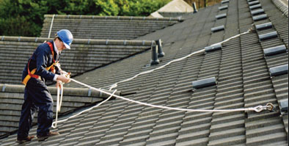
Anchorage for Fall Protection
Fall Arrest Systems – Consist of a point of anchorage on exposed roofs where a lanyard or lifeline can be securely fastened.

Slide 15
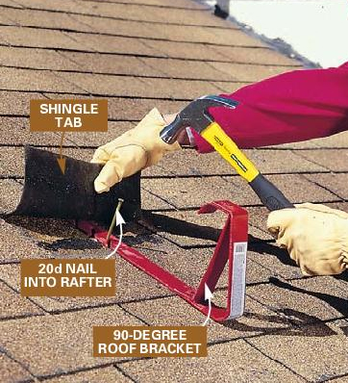
Anchorage for Fall Protection
Fall protection is only as effective as its anchorage.
Vertical lifelines must have a minimum breaking strength of 5,000 pounds.
One person per anchor unless designed otherwise.

Slide 16
Suitable Anchorage Points
Existing roofs rarely include a designed anchorage system.
Suitable Points Include:
Large HVAC Units
Large Masonry Chimneys
Pipes more than 10” in diameter
Roof anchors into interior beams
Concrete or steel columns and beams
Missionary Walls 8” thick with a 2’ spread plate

Slide 17
Unsuitable Anchorage Points
NEVER Anchor to:
Scuppers
Drain covers
Pipes less than 10” in diameter
Handrails
Roof hatches
Fixed ladders
Vent pipes
Shoring jacks
Form work

Slide 18
Securing Roof Openings/Skylights
Know all locations of roof openings.
Be sure all openings have proper covers or guardrails.
If covers are used, be sure they are properly secured to prevent from removal.
Be sure all covered openings are clearly marked with highly visible paint.

Slide 19
Roof Opening Case #2
Employee #1 and five laborers were performing built-up roofing work on a large warehouse.
Nearing completion, the workers began to remove tools and materials from the roof.
One employee went to the north end of the warehouse roof to collect tools and noticed that a plastic skylight dome had broken.
Peering through the opening, he saw employee #1 lying on the floor 26 feet below.

Slide 20
Roof Opening Case #2
Employee #1 died after placing himself on the skylight that broke under his weight.
Employee #1 had allegedly been drinking and wearing radio headphones.
The medical examiner stated upon arriving to the site, employee #1 reeked of alcohol.
The employer had failed to provide guardrails, screens, or other fall protection for the skylights.

Slide 21
Housekeeping
Inspect your work area on the roof and ground for unnecessary tools (cords), equipment, materials and supplies.
Organize your storage area on the roof, 10’ or more from the roof edge.
Items that are not needed should be removed from the project.

Slide 22
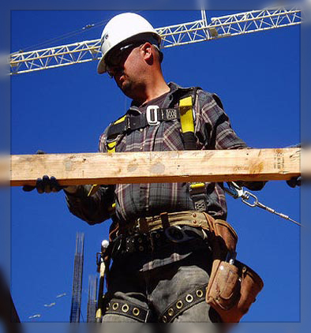
Basic Housekeeping Rules
Walking and working surface should be clean and unobstructed.
Approved dumpsters should be provided.
Proper chutes should be set up.
Loose materials should be picked up regularly.

Slide 23
Poor Housekeeping Can Lead To
Slips – From slick or wet roof, platform, and other walking surfaces including ladders and stairs.
Trips – From objects or materials that are left in walkways and work areas.
Falls – Into holes on walking or working surfaces, uneven roof, covered roof openings, drains, and pallets that are used as ladders or inadequate platforms.
Collisions – Caused by poorly stored materials, overhanging or protruding objects, haphazard storing of material, and storing of materials and equipment too close to the edge of the roof.

Slide 24
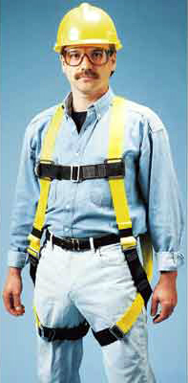
In Conclusion
Many workers are overly confident with their own abilities to survive and feel that safety equipment doesn’t look “cool”.
The truth is, there’s nothing “cool” about falling to your death.

Slide 25
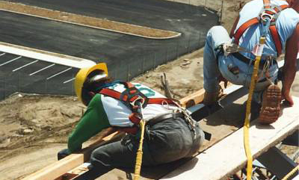
In Conclusion
Recognize a Safety Hazard before it becomes an accident.
Prevent future accidents with proper housekeeping techniques.
Be prepared with the use of Fall Protection Systems designed to save you in the event of a fall.

Slide 26
Always Take Roofing Safety...
One Step at a Time

