Slide 1
Safety orientation for new employees

Slide 2
topics covered
General
Hazard Communication
Personal Protective Equipment
Fall Protection
Equipment Usage
Lockout/Tagout
Material Handling
Confined Space Entry
Fire Prevention
Bloodborne Pathogens
Heat/Cold Stress
Basic First Aid
Accident Reporting
Emergency Response
Contact Information

Slide 3
General Safety Policy
No Smoking except in designated smoking areas.
No drug or alcohol use during working hours.
Wear the proper Personal Protective Equipment (PPE).
All injuries must be immediately reported to a supervisor.

Slide 4
General Safety Policy
Keep working area clean and clear of any materials that could cause injuries or illness.
Use tools that are OSHA compliant.
Always use the right tool for the job.
Notify your supervisor or the Safety Coordinator if you notice any spills, conditions, or any procedures that you feel may cause personal injury or illness to yourself or other employees.

Slide 5
Hazard Communication
All employees have the “right to know” what hazardous chemicals are present in their work environment.
Our Company has a program in place that makes sure chemicals are communicated through training, making Material Safety Data Sheets (MSDS’s) available, and container labeling.

Slide 6
Material Safety Data Sheets
Identity of Material and Manufacturer
Hazardous Ingredients
Physical and Chemical Characteristics
Fire and Explosion Hazard Data
Reactivity Data
Health Hazard Data (Limits, Symptoms, etc.)
Precautions for Safe Handling
Control Measures and First Aid

Slide 7


Chemical Hazards
Flammable/Explosion
Flash point
LEL
Toxic/Poison
Acute / Chronic
Local / Systemic
Routes of entry
Reactive
Corrosive

Slide 8
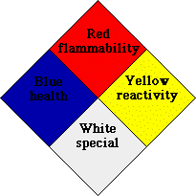
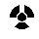
NFPA Diamond
Flash Points
4 - <73 degrees F
3 - <100 degrees F
2 - <200 degrees F
1 - <200 degrees F
0 – Will not burn
4 – Severe
3 - Serious
2 - Moderate
1 – Slight
0 – None
ACID
ALK
COR
OXY
Polymerization – P
Radioactivity -
Use No Water - W
4 – May Detonate
3 - Explosive
2 - Unstable
1 – Normally Stable
0 – Stable

Slide 9
Physical Hazards
Flammable materials
Materials that easily catch on fire and burn, such as acetylene, methane, acetone, and gasoline.
Pyrophoric materials
Materials that spontaneously ignite and burn when released into the atmosphere for example silane.
Oxidizers
Materials that accelerate combustion or cause readily combustible materials to ignite and burn.
Oxidizers need to be stored at least 20 feet from combustible materials.

Slide 10
Health Hazards
Carcinogens
Studies have shown that they can cause cancer.
Hepatotoxins
These can cause liver damage. An example is carbon tetrachloride.
Nephrotoxins
These can cause kidney damage. Examples are chlorine and fluorine.
Teratogen
This is a substance that can cause damage to a fetus resulting in malformation in the child's development.
Mutagens
A substance that is capable of altering the genetic materials in a living organism.
Asphyxiants
If it displaces enough oxygen can be fatal. Examples of this are nitrogen and helium.
Irritants
Cause an inflammation of the skin, eyes and respiratory tract.

Slide 11
Chemical Labeling
All chemicals that enter the physical plant must have the fallowing information clearly labeled.
Chemical name
Appropriate hazard warning
Name and address of the supplier
If there is any question about the labeling on incoming materials the container should be quarantined and the EHS Coordinator notified.
MSDS report must be received before a new chemical is used in the physical plant.

Slide 12
Personal Protective Equipment (PPE)
PPE is any outer shell that a worker uses to protect him or herself from certain hazards.
Keene State provides all employees that are exposed to real or potential hazards with proper PPE for the job.
And requires that it is used while performing the task.

Slide 13
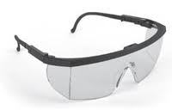
PPE
Eye Protection
Safety glasses protect your eyes from dust chippings, and light.
Safety glasses are required in all shop workstations.
Approved safety glasses will be supplied and can be accessed at Central Stores.
Contact lenses are not considered eye protection.

Slide 14

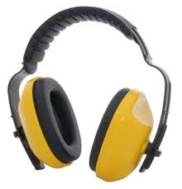
PPE
Ear Protection
All employees that are exposed to a high volume of noise are required to use ear protection.
A set of ear muffs will be given to employees that are required to use them.
A generous amount of ear plugs will be provided to everyone.

Slide 15

PPE
Hardhats, gloves, dust mask and respirators will be supplied to employees that need to wear them for certain jobs.
If your job requires steel toed shoes and boots the Company will reimburse full year full time employees to purchase on their own.

Slide 16
PPE
In order for this policy to work, everyone needs to be involved.
The employees needs to be responsible for the use and care of their PPE.
Supervisors need to make sure that employees are wearing and properly using PPE.

Slide 17
Fall Protection
Any open edge higher than four (4) feet
Guardrail System
Safety Net System
Personal Fall Arrest System
Any fixed ladder higher than 20 feet
Ladder Safety Device (with body harness)
Safety Cage with offset landings every 30 feet
Bucket truck/aerial lifts

Slide 18
Personal Fall Arrest System
Full Body Harness
Lanyard (regular or retractable)
Shock Absorber
Locking Snap Hooks
Lifeline (as needed)
Anchorage
Must hold 5000 lbs.

Slide 19
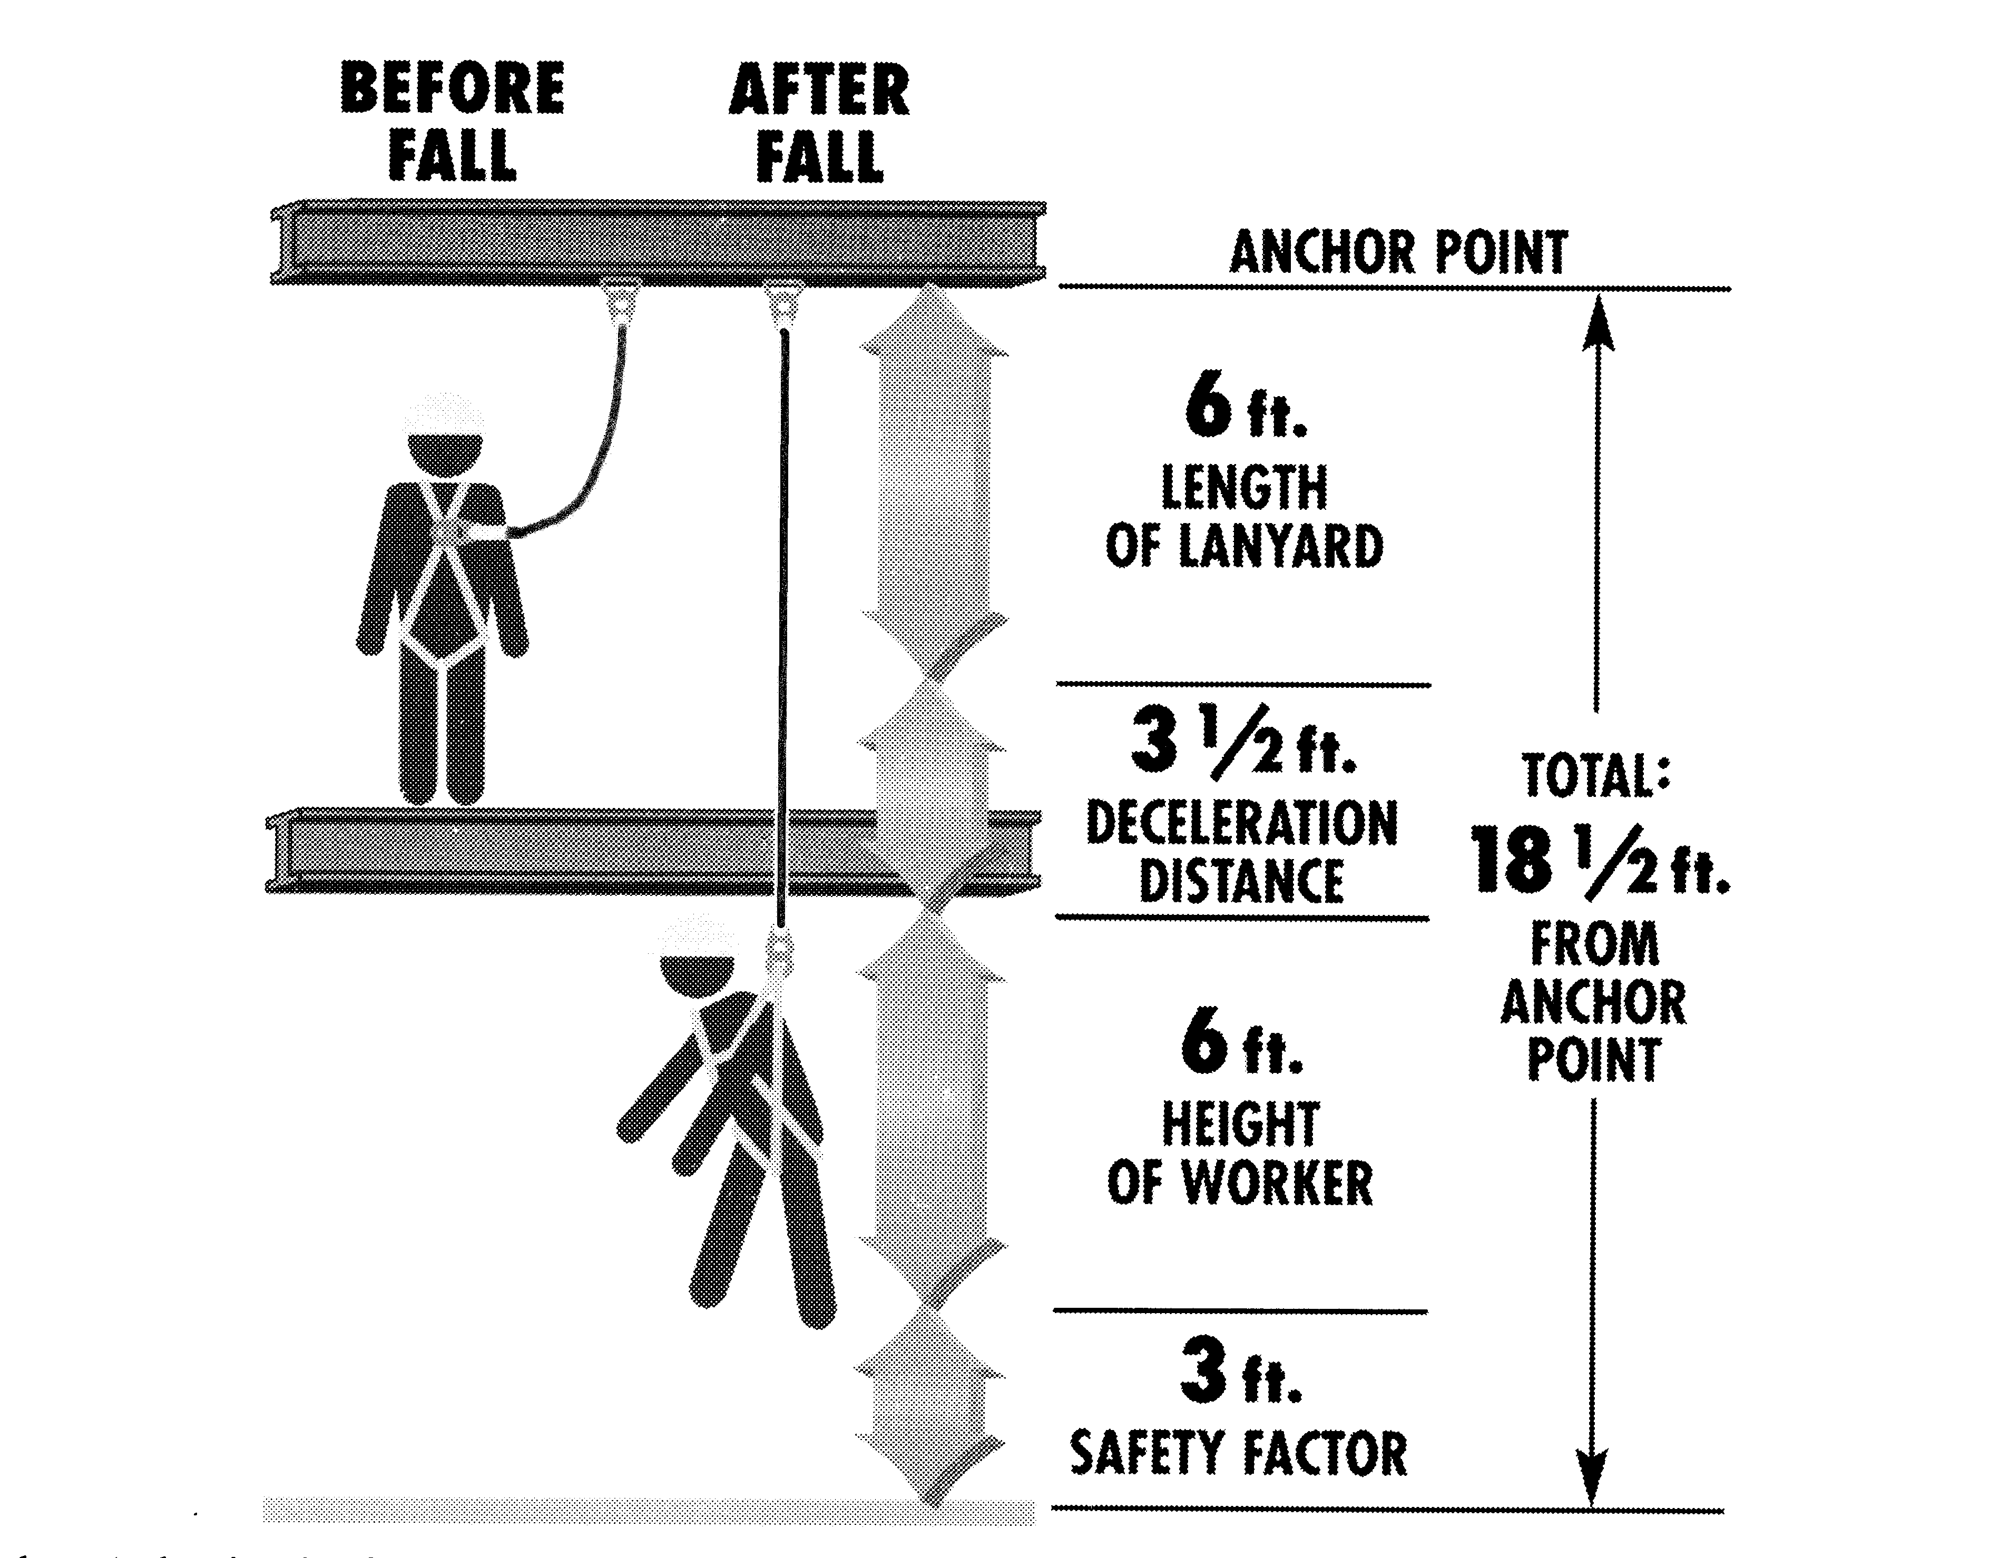
Fall Clearance (not a sale!)

Slide 20
Scaffolding
Erected by “Competent Person”.
Sound, rigid footing.
No overloading.
Scaffold Grade Planking.
Railings /toeboards
Tie-Off if no railing.
Access ladders.
Get down from “rolling” scaffold to move it.
No portable ladders on scaffolding.

Slide 21
Portable Ladders
Use only approved ladders.
Inspect before use.
Use both hands.
One person only.
Firm, level footing.
Do not use as platform or scaffold.
Use fall arrest if > 6 ft. working from ladder.
Secure top of extension ladders.
Extend 3 feet above access or working level.
Use 4:1 lean ratio.

Slide 22
Aerial Lifts
Secure lanyard to anchor point.
Never use a ladder from a lift.
Don’t over extend boom lifts.
Follow manufacturer’s safety notices.

Slide 23
Equipment Usage and Safeguarding
Guards should be in place on equipment whenever grinding or cutting work is performed.
Use tools that are grounded
This means cord must have three pronged plugs.
Always use the right tool for the job.
Understand Lockout/Tagout.

Slide 24
What is Lockout Tagout
Lockout/tagout is an OSHA standard that outlines procedures to prevent accidents and injuries caused by the release of energy such as.
Electrical
Mechanical
Pneumatic (air pressure)
Hydraulic
Fluids and gases
The lockout device is put on to guarantee that the equipment is shut off.
IF you see a lock or a tag, DO NOT TOUCH.

Slide 25
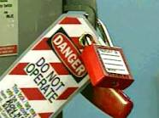
Lockout

Slide 26
General Lockout/Tagout Procedure
Before shutting down, notify all affected employees.
Locate all energy sources.
Shutdown machine by regular methods.
Isolate the machines by shutting down the main power source to the machine.
Lockout
Place lock or tag on power switch in the off position at the main power source.
Energy Release to make sure that there is no stored energy in the machine.
Test the machine to make sure the machine will not turn on.
Remember only authorized personnel can remove the lock or tag. All other employees should not touch anything that is locked or tagged.

Slide 27

Tagout

Slide 28
Material Handling
Try not to lift manually; if possible use forklift, dolly or hand cart.
If you need to lift manually employ the following safe lifting techniques.
Size up a load before lifting.
Bend at the knees, you want to lift with your legs not your back.
Do not twist or turn your body once you have made the lift. Keep the load close to your body.
Always push objects rather than pull if possible
Get help with bulky Items.

Slide 29
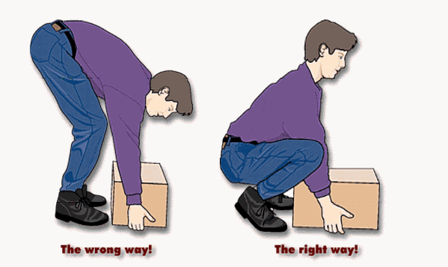
lifting

Slide 30
General Cylinder Handling and Transporting
Report any leaking cylinders to your supervisor immediately.
Secure all cylinders when not in use.
All cylinders must be labeled or marked legibly to identify the contents.
All other potentially confusing markings must be removed.
Before transporting a cylinder all valve caps and plugs must be in place.
When ever possible transport cylinders by cart rather by hand.

Slide 31
Confined Space Entry
Only Authorized, specially trained employees may enter confined spaces.
Before entering a confined space you must always check the atmosphere for adequate oxygen, and the presence of any flammable or toxic gases.
Ventilation may need to be provided.
Retrieval equipment must be set up and used.
The Safety Department must be notified whenever there is a confined space entry.

Slide 32
Example of Confined Spaces
Tanks
Manholes
Boilers
Dike areas
Tunnels
Sewers
Stacks/chimneys
Ducts
Underground utility vaults
Steam Condensers

Slide 33
Fire Prevention
In the event a fire occurs employees should pull a fire alarm, get out of the building and dial 911.
Fire evacuation procedures are posted in class buildings showing evacuation routes.
Fire alarms are located in every building near exits and in hall ways.
Fire extinguishers are also located in every building but should only be used by employees that have been properly trained.

Slide 34
Fire Extinguishers
In the event you need to use a fire extinguisher it is very important to use the proper type.
Class A extinguisher are water or dry chemical and should be used for wood, paper, or plastics.
Class B extinguisher are carbon dioxide, dry chemical, or water fog. This type is used for liquids or vapors.
Class C extinguishers are carbon dioxide or dry chemical. This type is used for electrical fire.
In the event that the fire is an electrical fire NEVER USE WATER.

Slide 35
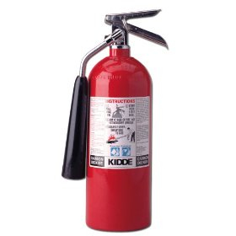
Fire Extinguisher Features
Operating lever
Locking pin
Pressure gauge
Discharge nozzle
Label
type of extinguisher (A,B,C)
instructions

Slide 36
Fire Extinguisher Use
Select correct extinguisher for class of fire.
P A S S –
Pull the locking pin.
Aim at base of fire.
Squeeze and hold the discharge lever.
Sweep from side to side.
CAUTION - monitor the area, the fire could re-ignite.
Always notify supervisor of extinguisher use.

Slide 37


Slide 38

Fire Prevention
There are three components that are necessary for a fire to burn.
If one of the components is taken away the fire will be extinguished.

Slide 39
Fire Prevention Safety Tips
Use electrical cords that are in good condition
Avoid using temporary wiring.
Only qualified personnel should work with wiring and electrical equipment.
Use flammable liquids in well ventilated areas away from ignition sources.
Keep flammable materials in closed or covered containers, stored away from ignition source.
Clean up any spills immediately.
Flammable containers should be stored in proper cabinets.
Keep work and storage areas clean.
No smoking except in designated areas.

Slide 40
Accident or Incident Reporting
Always notify your supervisor of any job related injuries.
Your supervisor can arrange for medical evaluations.
You can also contact the Human Resource Department for assistance.
Injuries that require lost time from work and/or hospitalization need to be immediately reported to the HR department.
Near Misses should also be reported.

Slide 41
Bloodborne Pathogens
Universal precautions to protect.
AIDS, Hepatitis
Hep-B vaccines for designated persons.
No contact with blood or body fluids.
Decontaminate spill areas with bleach or other disinfectant.
Wear protective equipment, especially gloves & safety glasses.
Hospital / Laboratory Waste - “Red Bag”.
First aid waste – double bag in thick plastic bags.
Sharps disposal.

Slide 42
Temperature Stress - Cold
Dress in layers.
Limit exposed skin.
Frostbite - localized frozen tissue
Do not rub area, limit motion, warm slowly.
Hypothermia - lowered body temperature
Remove wet clothing, use dry blankets.
Seek medical attention.

Slide 43
Temperature Stress - Heat
Sunburn - keep skin covered.
Heat Cramps - drink dilute “Gatorade”.
Heat Exhaustion - heavy sweating, cool skin
Cool victim, seek medical attention if vomiting.
Heat Stroke - medical emergency
Hot, dry skin, rapid then weakening pulse.
Cool victim immediately.

Slide 44
Basic First Aid
Shock
Lay victim down
Keep victim warm
Keep victim calm
Get assistance
Bleeding
Use clean bandage
Apply pressure
Elevate wound
Burns
1st Degree - redness only, flush with cool water
2nd Degree - blisters, place damp bandage, use no ointments
3rd Degree - white or charred, use dry bandage
2nd or 3rd - get medical attention

Slide 45
Basic First Aid, cont.
Fractures
Closed fractures - (no protruding bones), immobilize
Open fractures - immobilize, control bleeding
Head and Neck Injuries
DO NOT MOVE VICTIM
Chemical Burns
Flush with water for 15 minutes minimum
Bites and Stings
Be aware of bee sting allergies
Poisonous bites - seek medical attention

Slide 46
Emergency Response
The company has an Emergency Operations Plan and other action plans that outline specific actions that need to take place in the event an emergency occurs.
These plans are located in the _____________ office.

Slide 47
Emergency Response
In the event a fire, chemical spill, or medical emergency occurs employees should contact __________.

