Slide 1
Slips, trips & falls - working on & around commercial motor vehicles

Slide 2
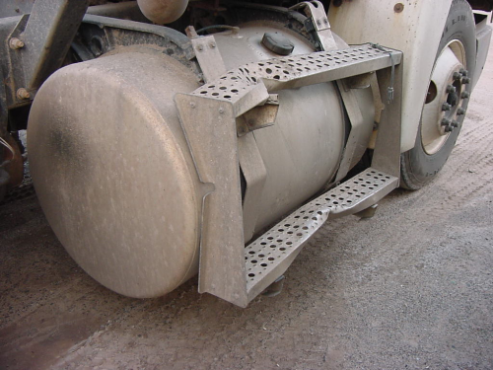
REDUCING SLIPS, TRIPS & FALLS
Inspect steps to ensure that there are no defects before climbing on. A quick visual check should be completed during the pre-trip inspection. Corrections should be made prior to use.

Slide 3
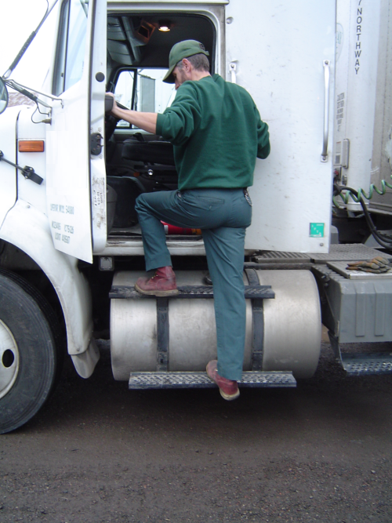
REDUCING SLIPS, TRIPS & FALLS
REDUCING SLIPS/TRIPS/FALLS
Always maintain a THREE POINT CONTACT (two feet/one hand or one foot/ two hands) when mounting or dismounting the tractor or trailer. Don’t climb into or out of the cab with something in your free hand.

Slide 4
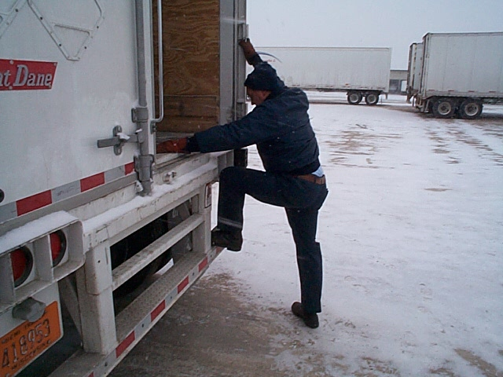
THREE POINT CONTACT
Use the three point system to climb in and out. Keep both hands and one foot or both feet and one hand in constant contact.
3
2
1

Slide 5
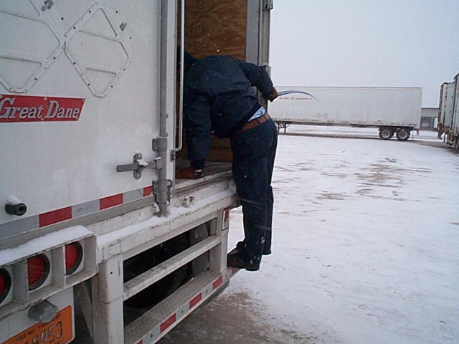
THREE POINT CONTACT
3
2
1
Keep three points of contact as you climb.

Slide 6
THREE POINT CONTACT
2
1
3
Watch where you step and keep a firm grip on the door as you climb down.

Slide 7
THREE POINT CONTACT
3
2
1
If you have steps on your trailer you can raise the door and
use them. You still need to keep three points of contact.

Slide 8
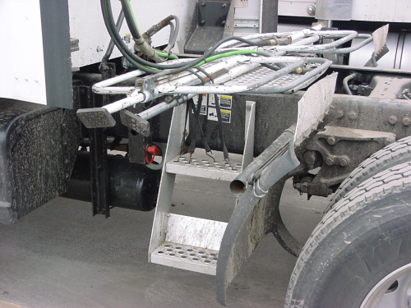
REDUCING SLIPS, TRIPS & FALLS
Before climbing on or exiting the vehicle, check for OBSTACLES on the ground or near steps (debris, cords, uneven surfaces) that could lead to potential slips, trips or falls.

Slide 9
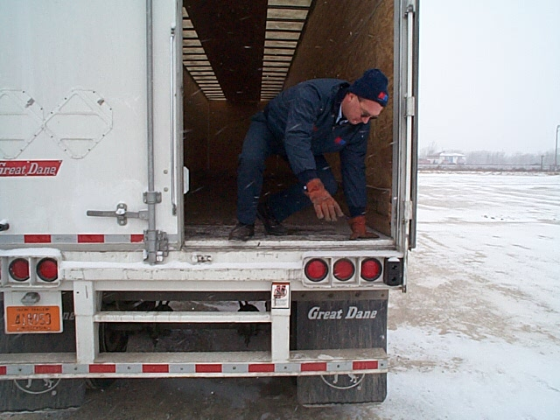
REDUCING SLIPS, TRIPS & FALLS
NEVER JUMP out of vehicle or trailer. Uneven ground surfaces are often present which can lead to a strained knees or ankles. This type of injury can have a significant impact on your ability to operate your vehicle.

Slide 10
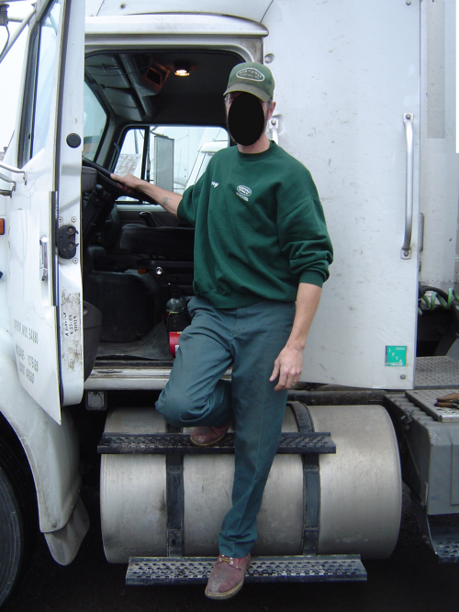
REDUCING SLIPS, TRIPS & FALLS
Always face the equipment, if you face away, falls are much more likely and three points of contact are not always possible. Never exit the tractor this way.

Slide 11
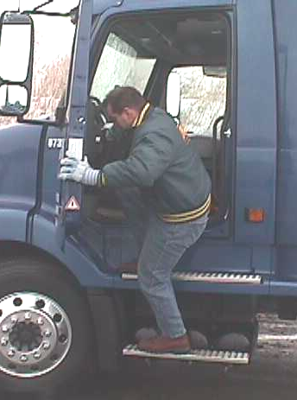
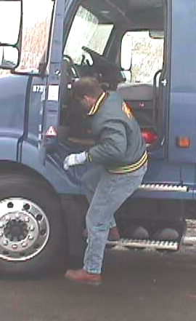
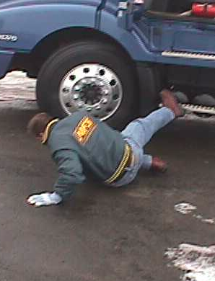
FACE THE EQUIPMENT WHEN MOUNTING/DISMOUNTING
If you face away from the tractor and start to fall you have no way to stop the fall

Slide 12
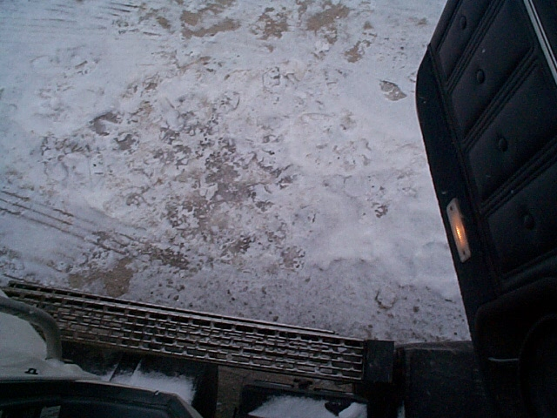
REDUCING SLIPS, TRIPS & FALLS
Be extra cautious when WINTER WEATHER conditions are present. Snow and ice can lead to slips/falls on both the ground and on truck steps. Ice should be cleared from steps and boots prior to climbing into vehicle.

Slide 13
REDUCING SLIPS, TRIPS & FALLS
Make sure your shoes are in good condition. Worn soles make slips and falls more likely. Avoid wearing cowboys boots, sandals, leather soles, or bare feet.

Slide 14
PREVENTING SLIPS, TRIPS & FALLS
DO’S
  Keep Equipment Clean (steps, hand rails, shoes, work surfaces).
  Use extra caution in bad weather.
  Get a firm grip with your hands and feet, not just your fingertips and tip. toes-
  THREE POINT CONTACT.
DONT’S
  Don’t Jump down, always climb.
  Make certain your muscles are awake and ready for the climb down.

Slide 15
MANUAL MATERIAL HANDLING INJURIES
Lifting/Lowering
Pushing/Pulling
Reaching/Bending
How do we Prevent?

Slide 16
MANUAL MATERIAL HANDLING INJURIES
Use forklifts whenever possible.
Don’t take short cuts to save time.
Avoid twisting as you lift-turn your feet.
Use the whole body, not just the back.
Keep the load close to you.

Slide 17
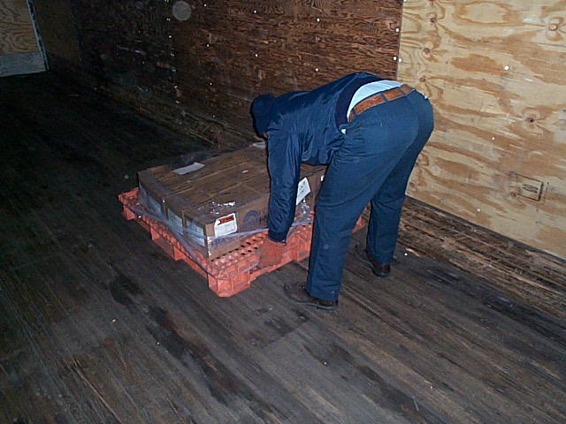
REACHING/BENDING
This pallet was only being moved a few feet. The best way would be to use a forklift.
Bending and reaching make this a back strain waiting to happen

Slide 18
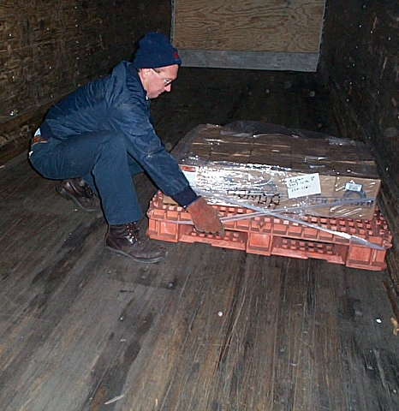
REACHING/BENDING
If you do have to move a pallet to reposition it, stay low and use the whole body.
A forklift or pallet jack would be the ideal solution in this case.

Slide 19
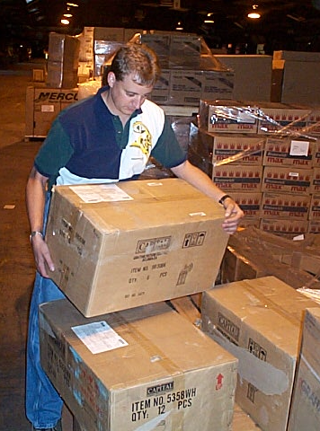
MANUALLY HANDLING BOXES
Keep the load close to your body.
Grasp it with both hands.
Spread your feet for balance.
Know the weight before you lift.
Lift then turn your body-avoid twisting while you lift.

Slide 20
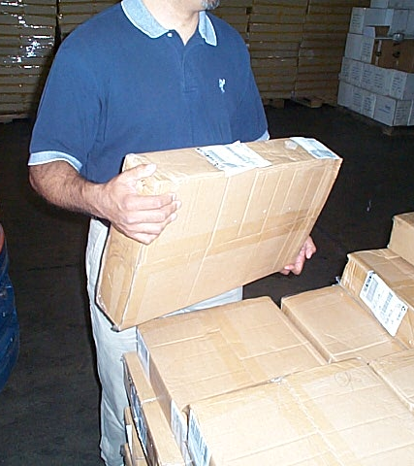
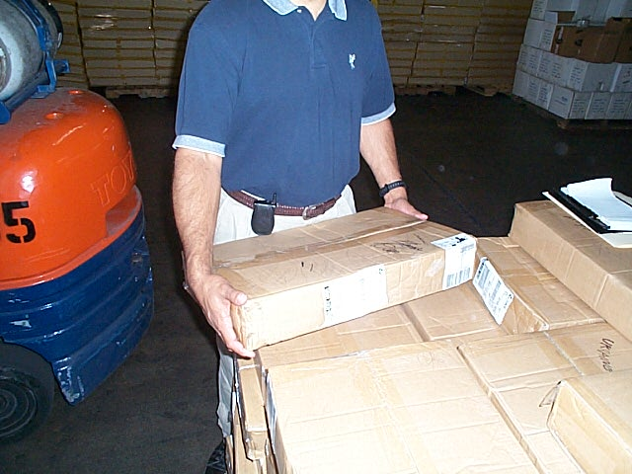
KEEP BOXES AND CARTONS AS CLOSE TO YOUR BODY AS POSSIBLE

Slide 21
KEEP THE WORK AREA ORGANIZED
Give yourself a path to move around pallets.
Avoid stepping over boxes.
Watch where you step.
Avoid moving the same box twice.

Slide 22
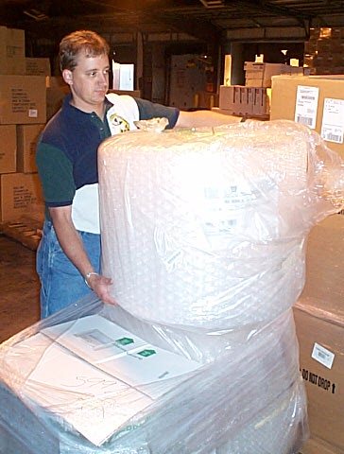
LIFTING OBJECTS
Some freight is light and easy to lift.

Slide 23
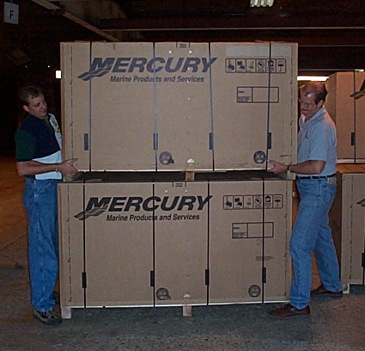
LIFTING OBJECTS
Other freight should only be moved with lift trucks or other mechanical means.

Slide 24
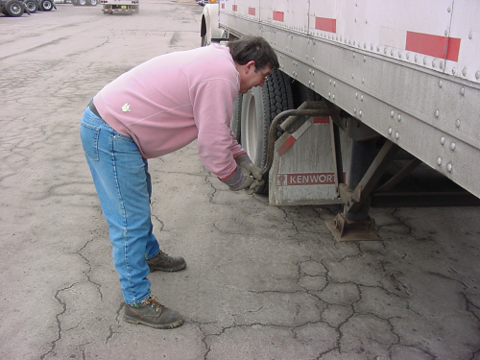
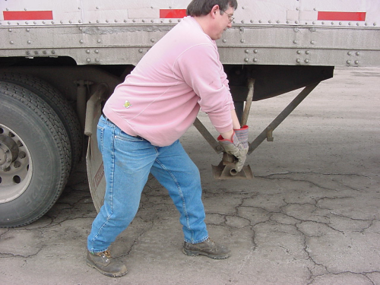
CRANKING LANDING GEARS - Which is Correct?

Slide 25
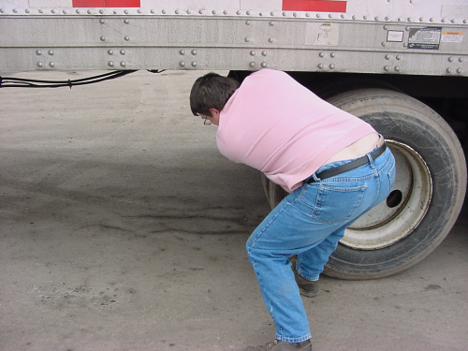
PULLING PIN ON 5TH WHEEL
How much force is required to pull fifth-wheel pin?
  10 lbs.
  30 lbs.
  75 lbs.
  100 lbs.
Use of Hooks
Pneumatic Devices

